Slide 1
Speech Recognition in a Medical Environment & Deep Learning Theory
Nicolas Shu
Committee Members:
David Anderson, Gari Clifford, Evangelos Theodorou

Slide 2


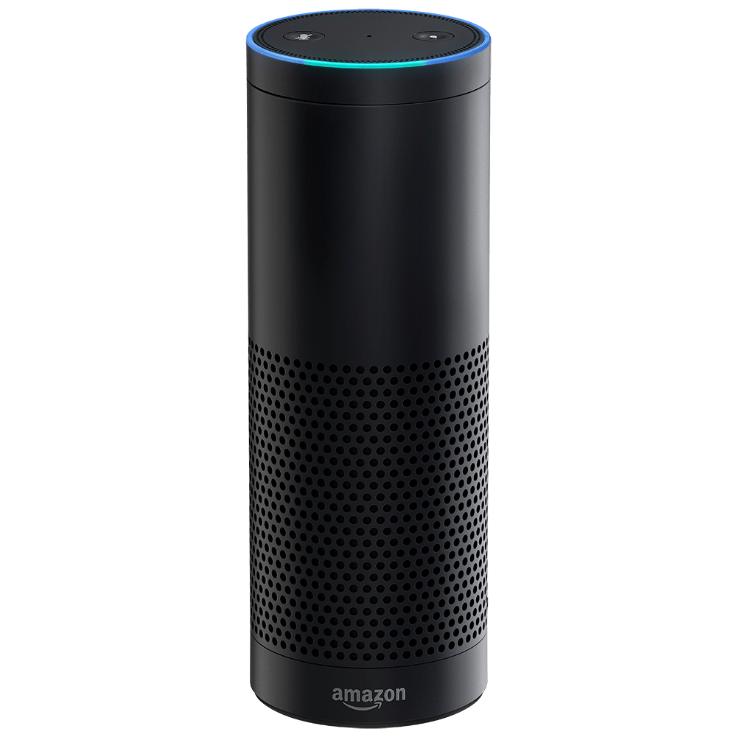

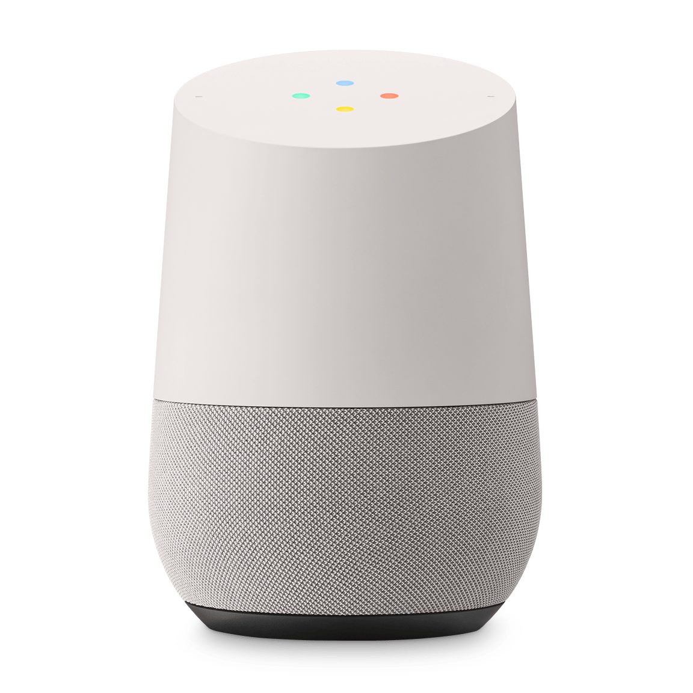

Background

Slide 3

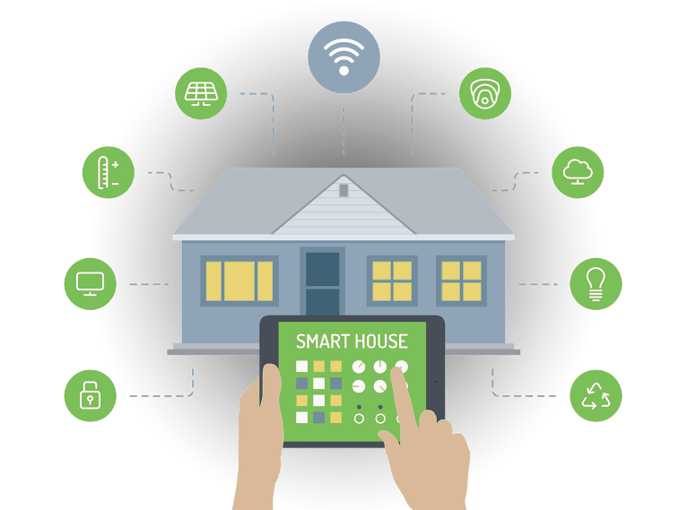
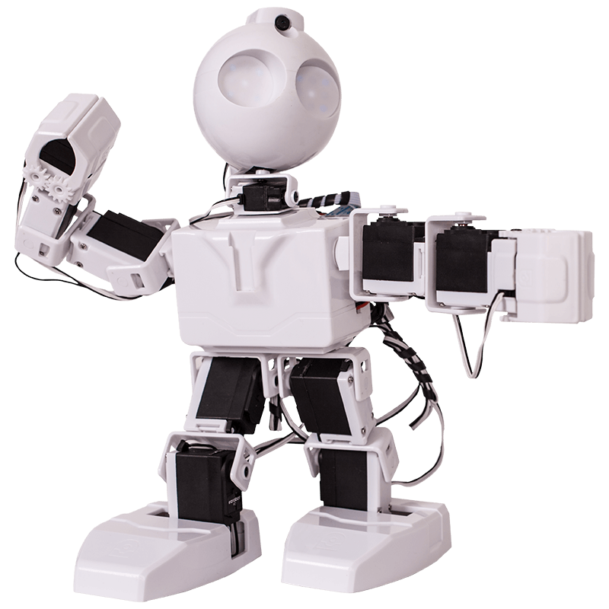



Background

Slide 4

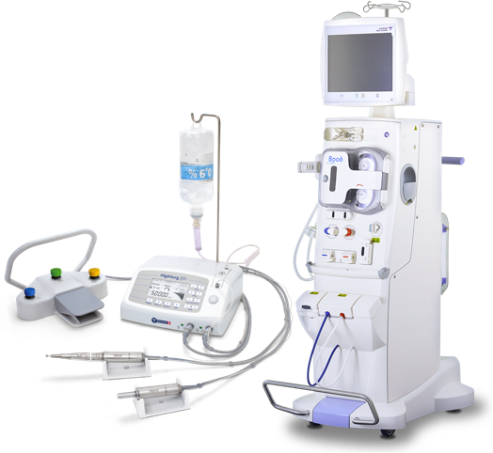

Background

Slide 5
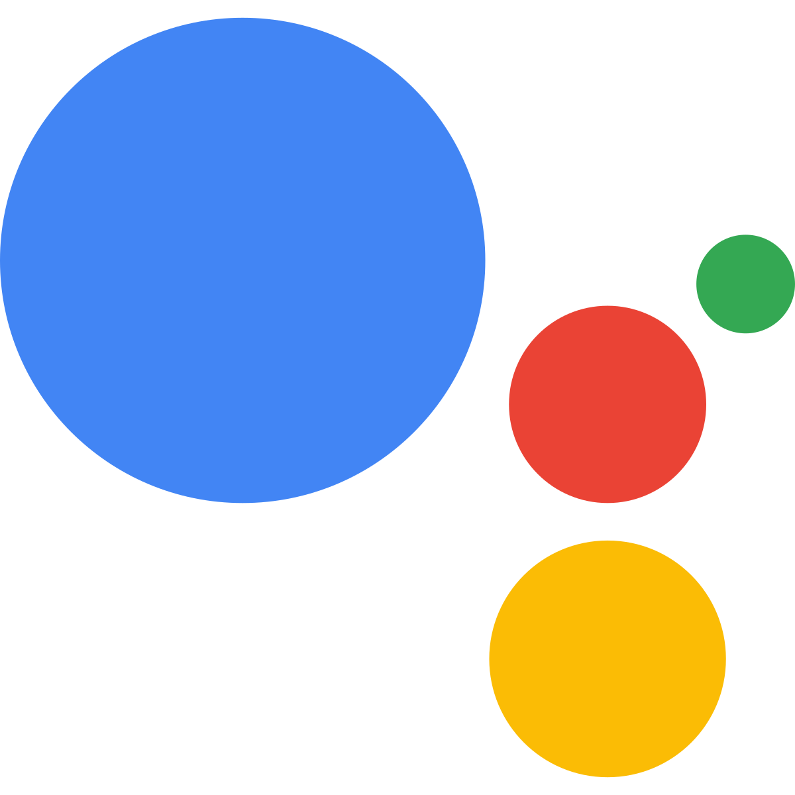




Background
Siri

Slide 6
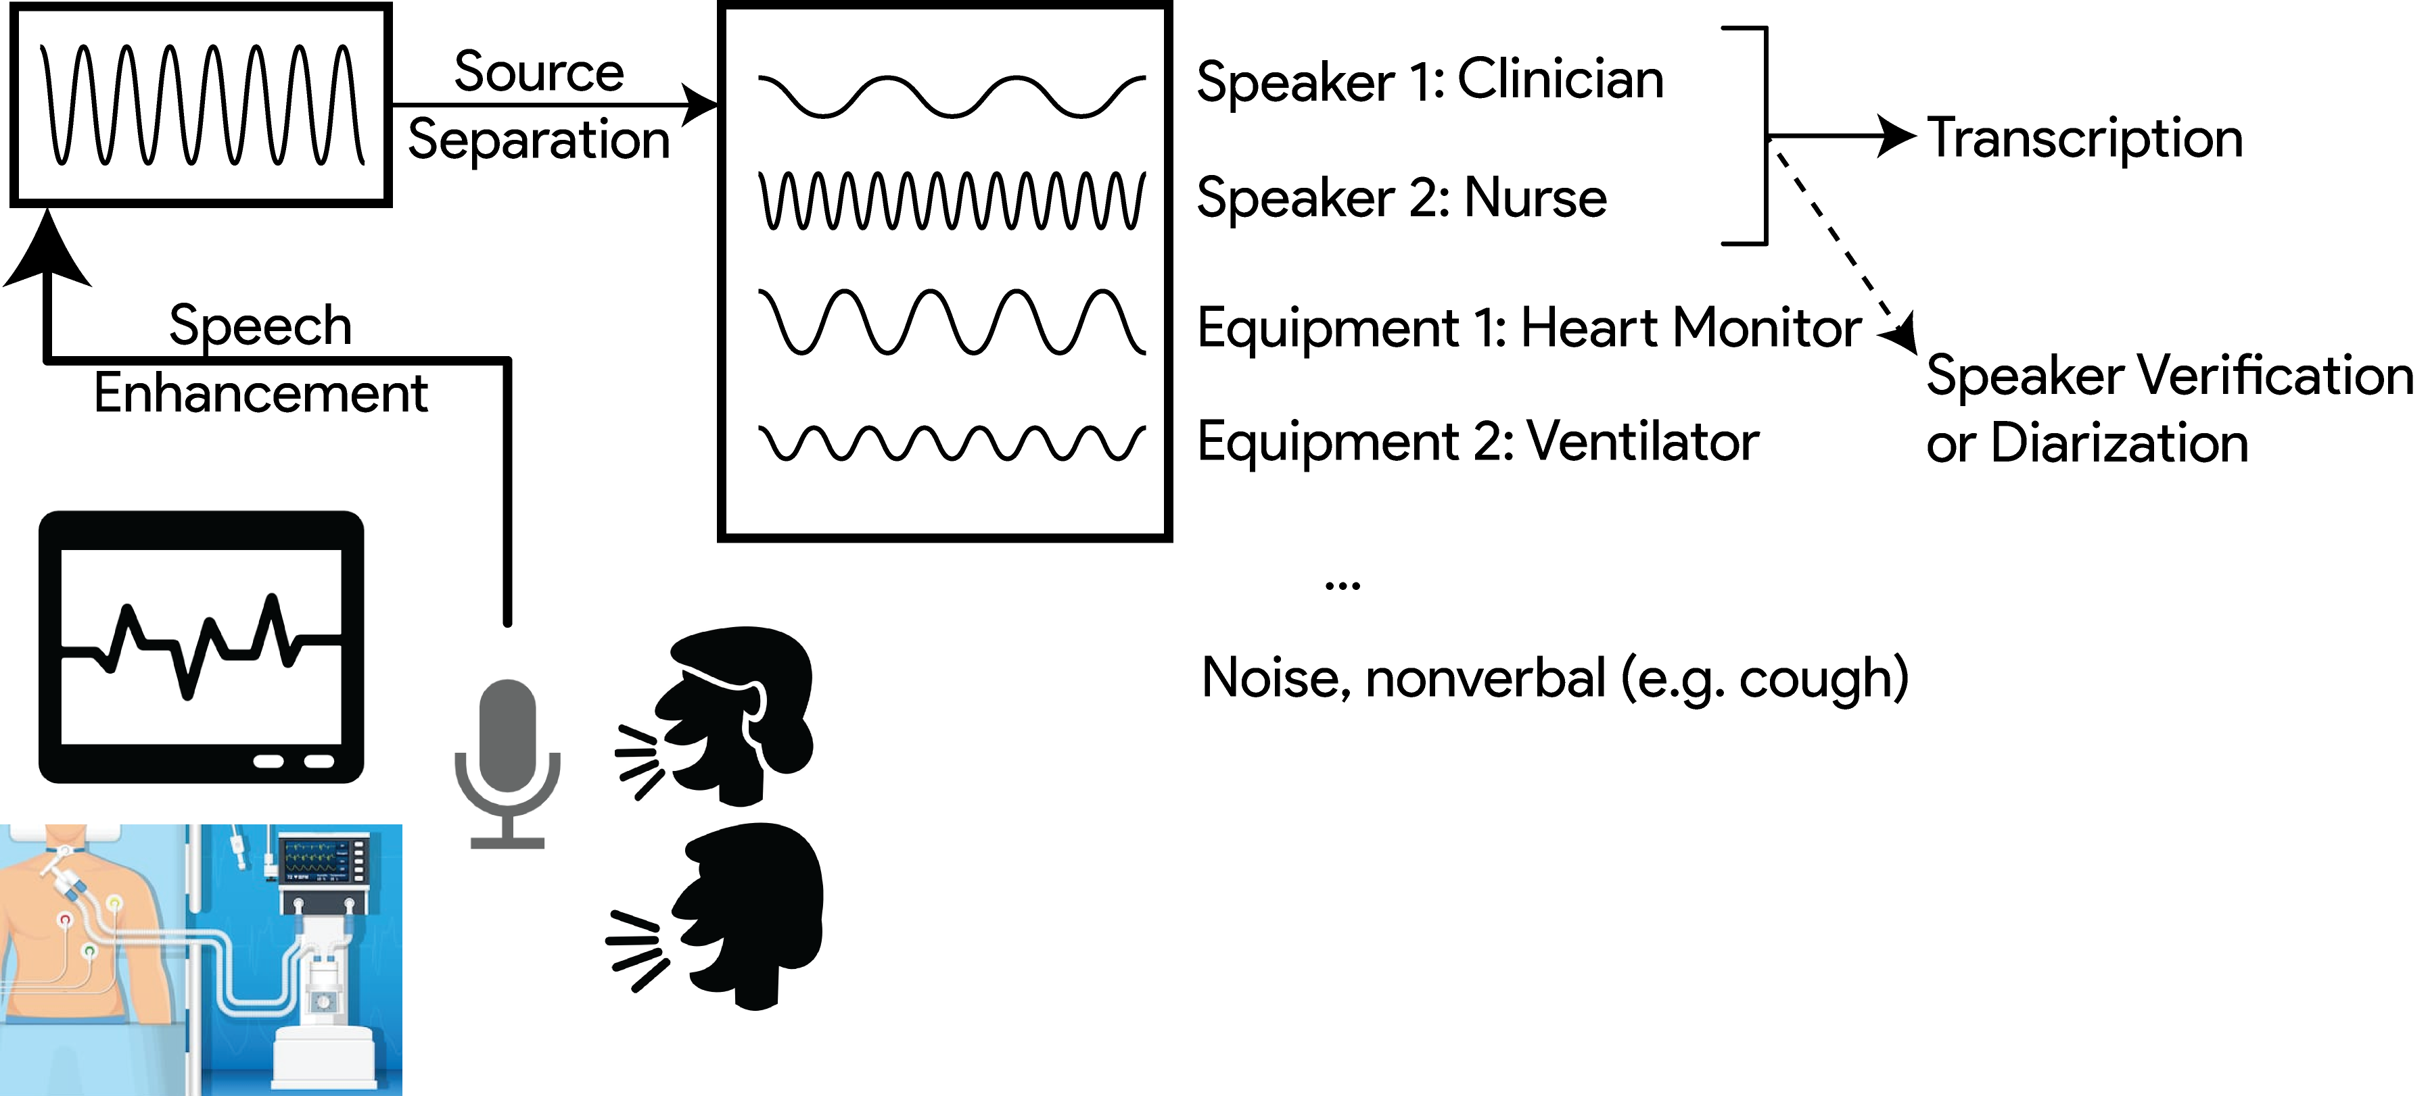
Background

Slide 7
Outline
Speech Processing
Speech Recognition
Blind Source Separation
Speech Enhancement
Speaker Verification & Speaker Diarization
Deep Learning Theory
Stochastic Thermodynamics of Learning
Deep Relaxation
Analyzing Neural Networks via Information Theory
Residual Networks as a Mean-Field Optimal Control Problem

Slide 8
Assumptions of Knowledge
Gaussian Mixture Models (GMM)
K-Means
K-Nearest Neighbors
Cepstrum Coefficients
Mel-Frequency Cepstrum Coefficients (MFCCs)
Linear Prediction Coefficients (LPCs)

Slide 9
Outline
Speech Processing
Speech Recognition
Blind Source Separation
Speech Enhancement
Speaker Verification & Speaker Diarization
Deep Learning Theory
Stochastic Thermodynamics of Learning
Deep Relaxation
Analyzing Neural Networks via Information Theory
Residual Networks as a Mean-Field Optimal Control Problem

Slide 10
Speech Recognition

Slide 11
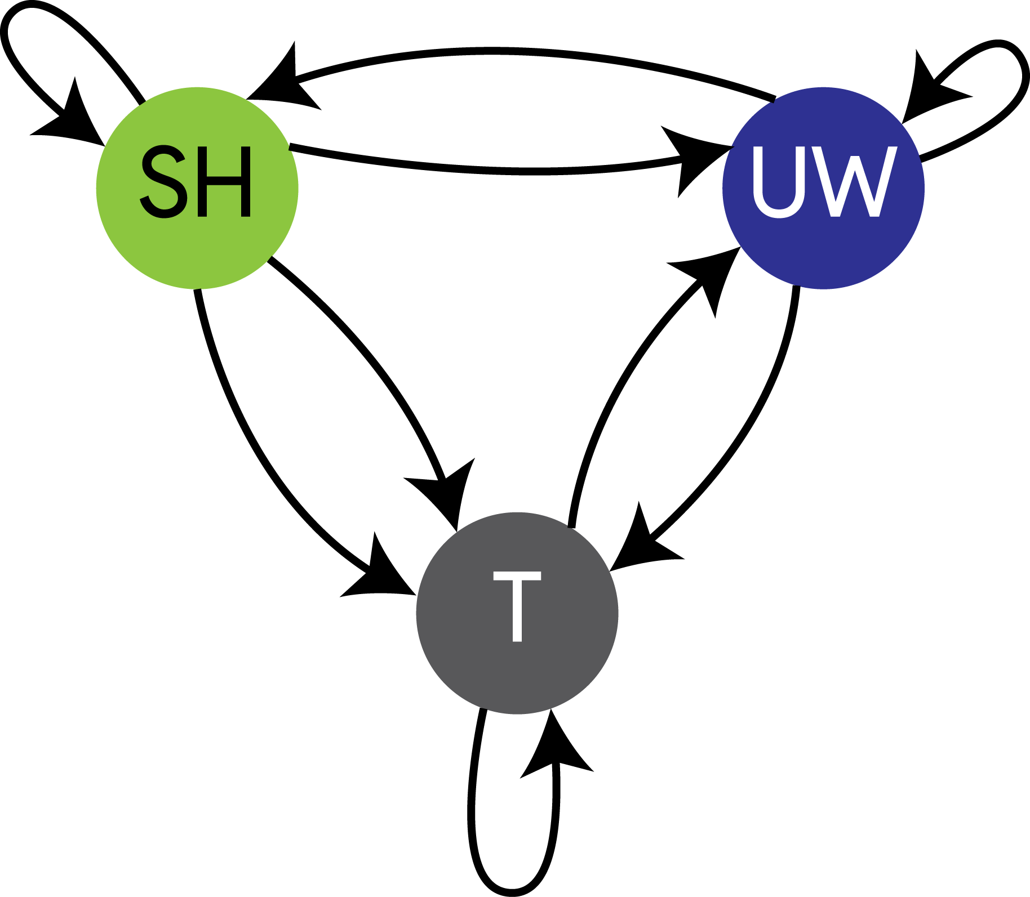
Speech Recognition – Hidden Markov Models
“Dynamic Gaussian Mixture Models (GMMs)”

Slide 12
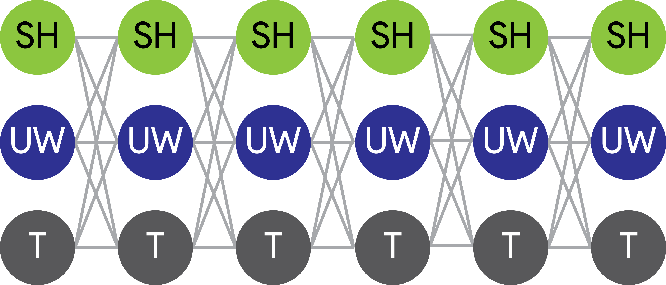
Speech Recognition – Hidden Markov Models
Time / Window
Training states with Baum-Welch Statistics

Slide 13
Speech Recognition – Hidden Markov Models
Training states with Baum-Welch Statistics
E.g. For GMMs, determine
Mean vectors
Covariance Matrices

Slide 14
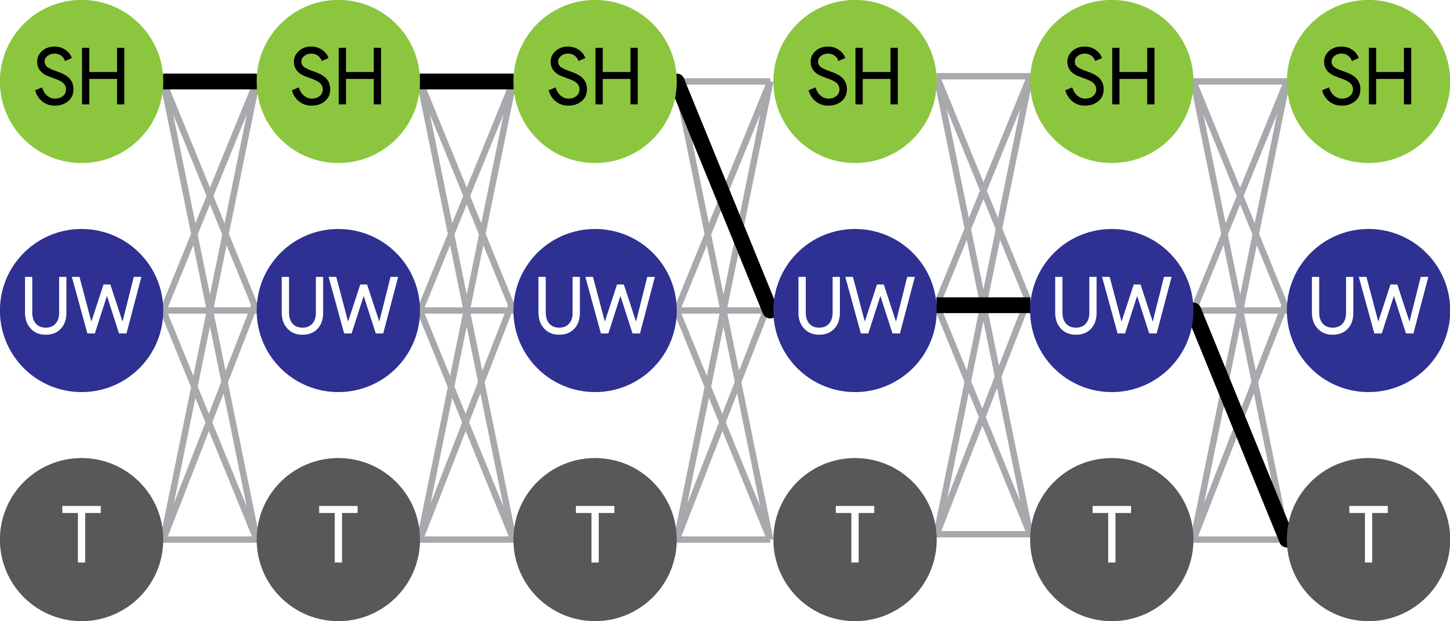
Speech Recognition – Hidden Markov Models
Time / Window

Slide 15
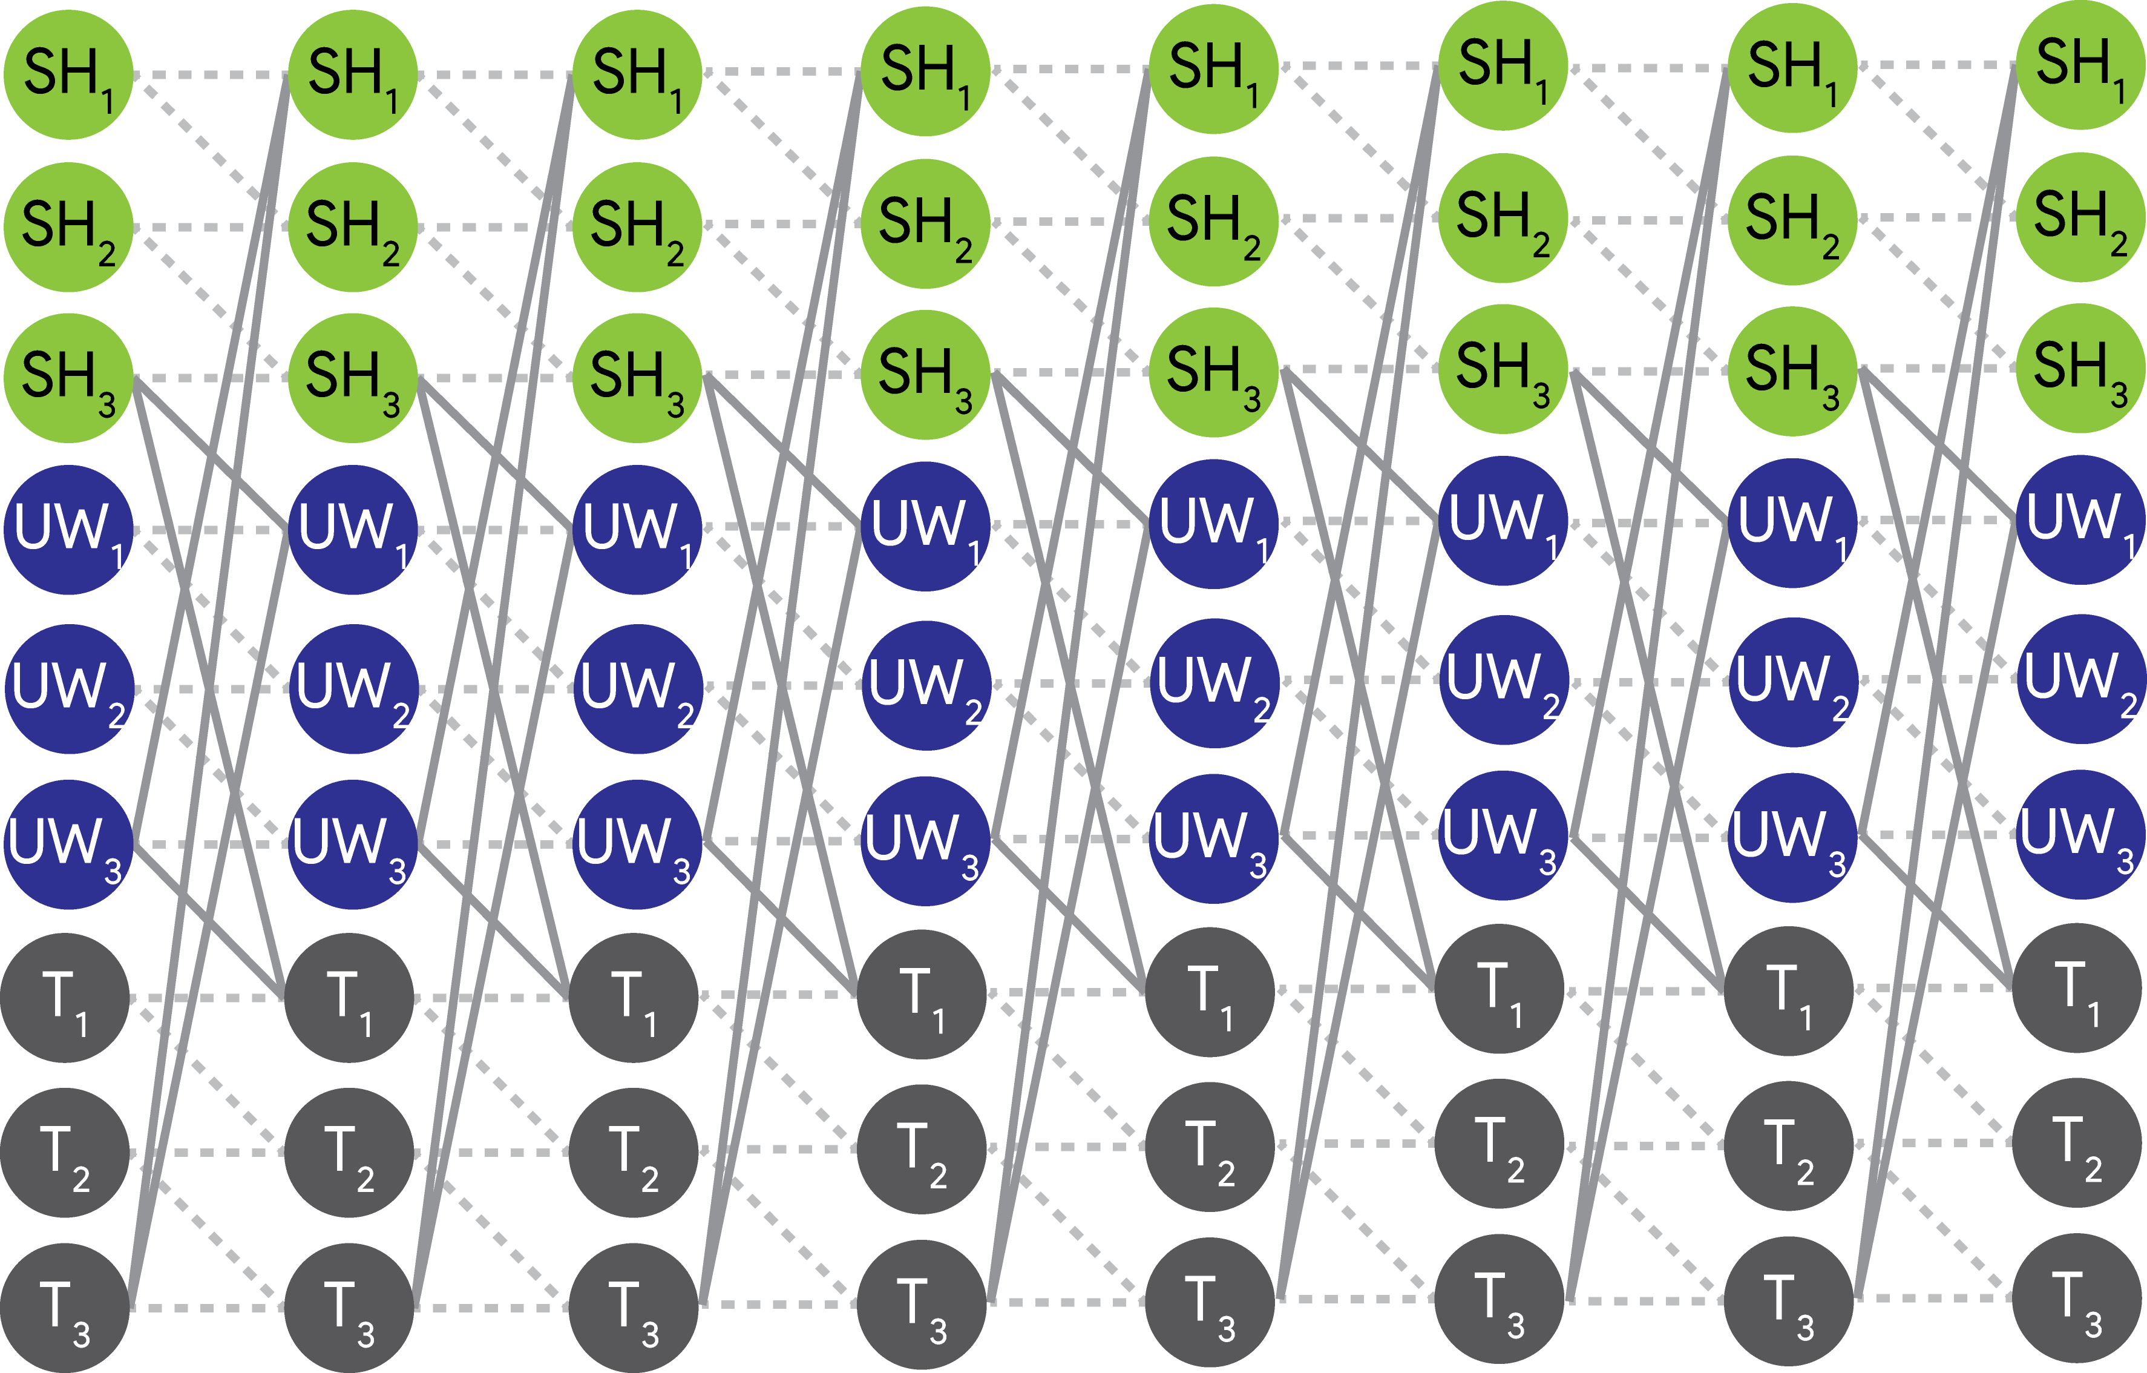
Speech Recognition – Hidden Markov Models

Slide 16
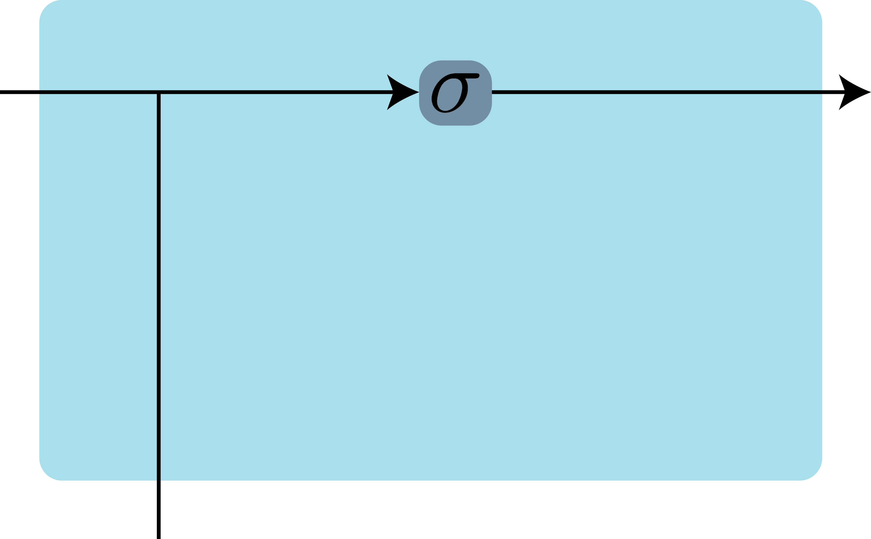
Speech Recognition – Deep Learning
t-1
t
Recurrent Neural Network

Slide 17
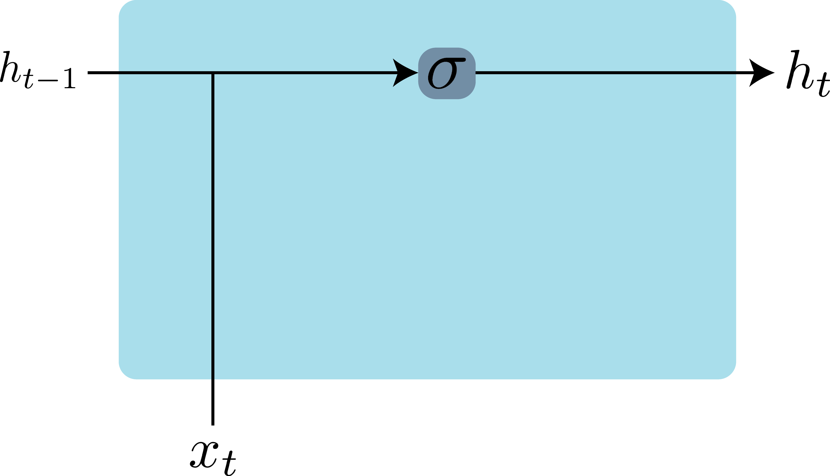

Speech Recognition – Deep Learning
Sigmoid
Recurrent Neural Network

Slide 18

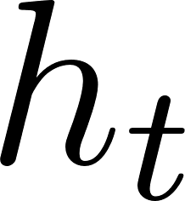

Speech Recognition – Deep Learning
Recurrent Neural Network

Slide 19
Speech Recognition – Deep Learning
Letters
Words
Phonemes
MFCC
Cepstrum Coefficients
Linear Prediction Coefficients
…
Recurrent Neural Network

Slide 20
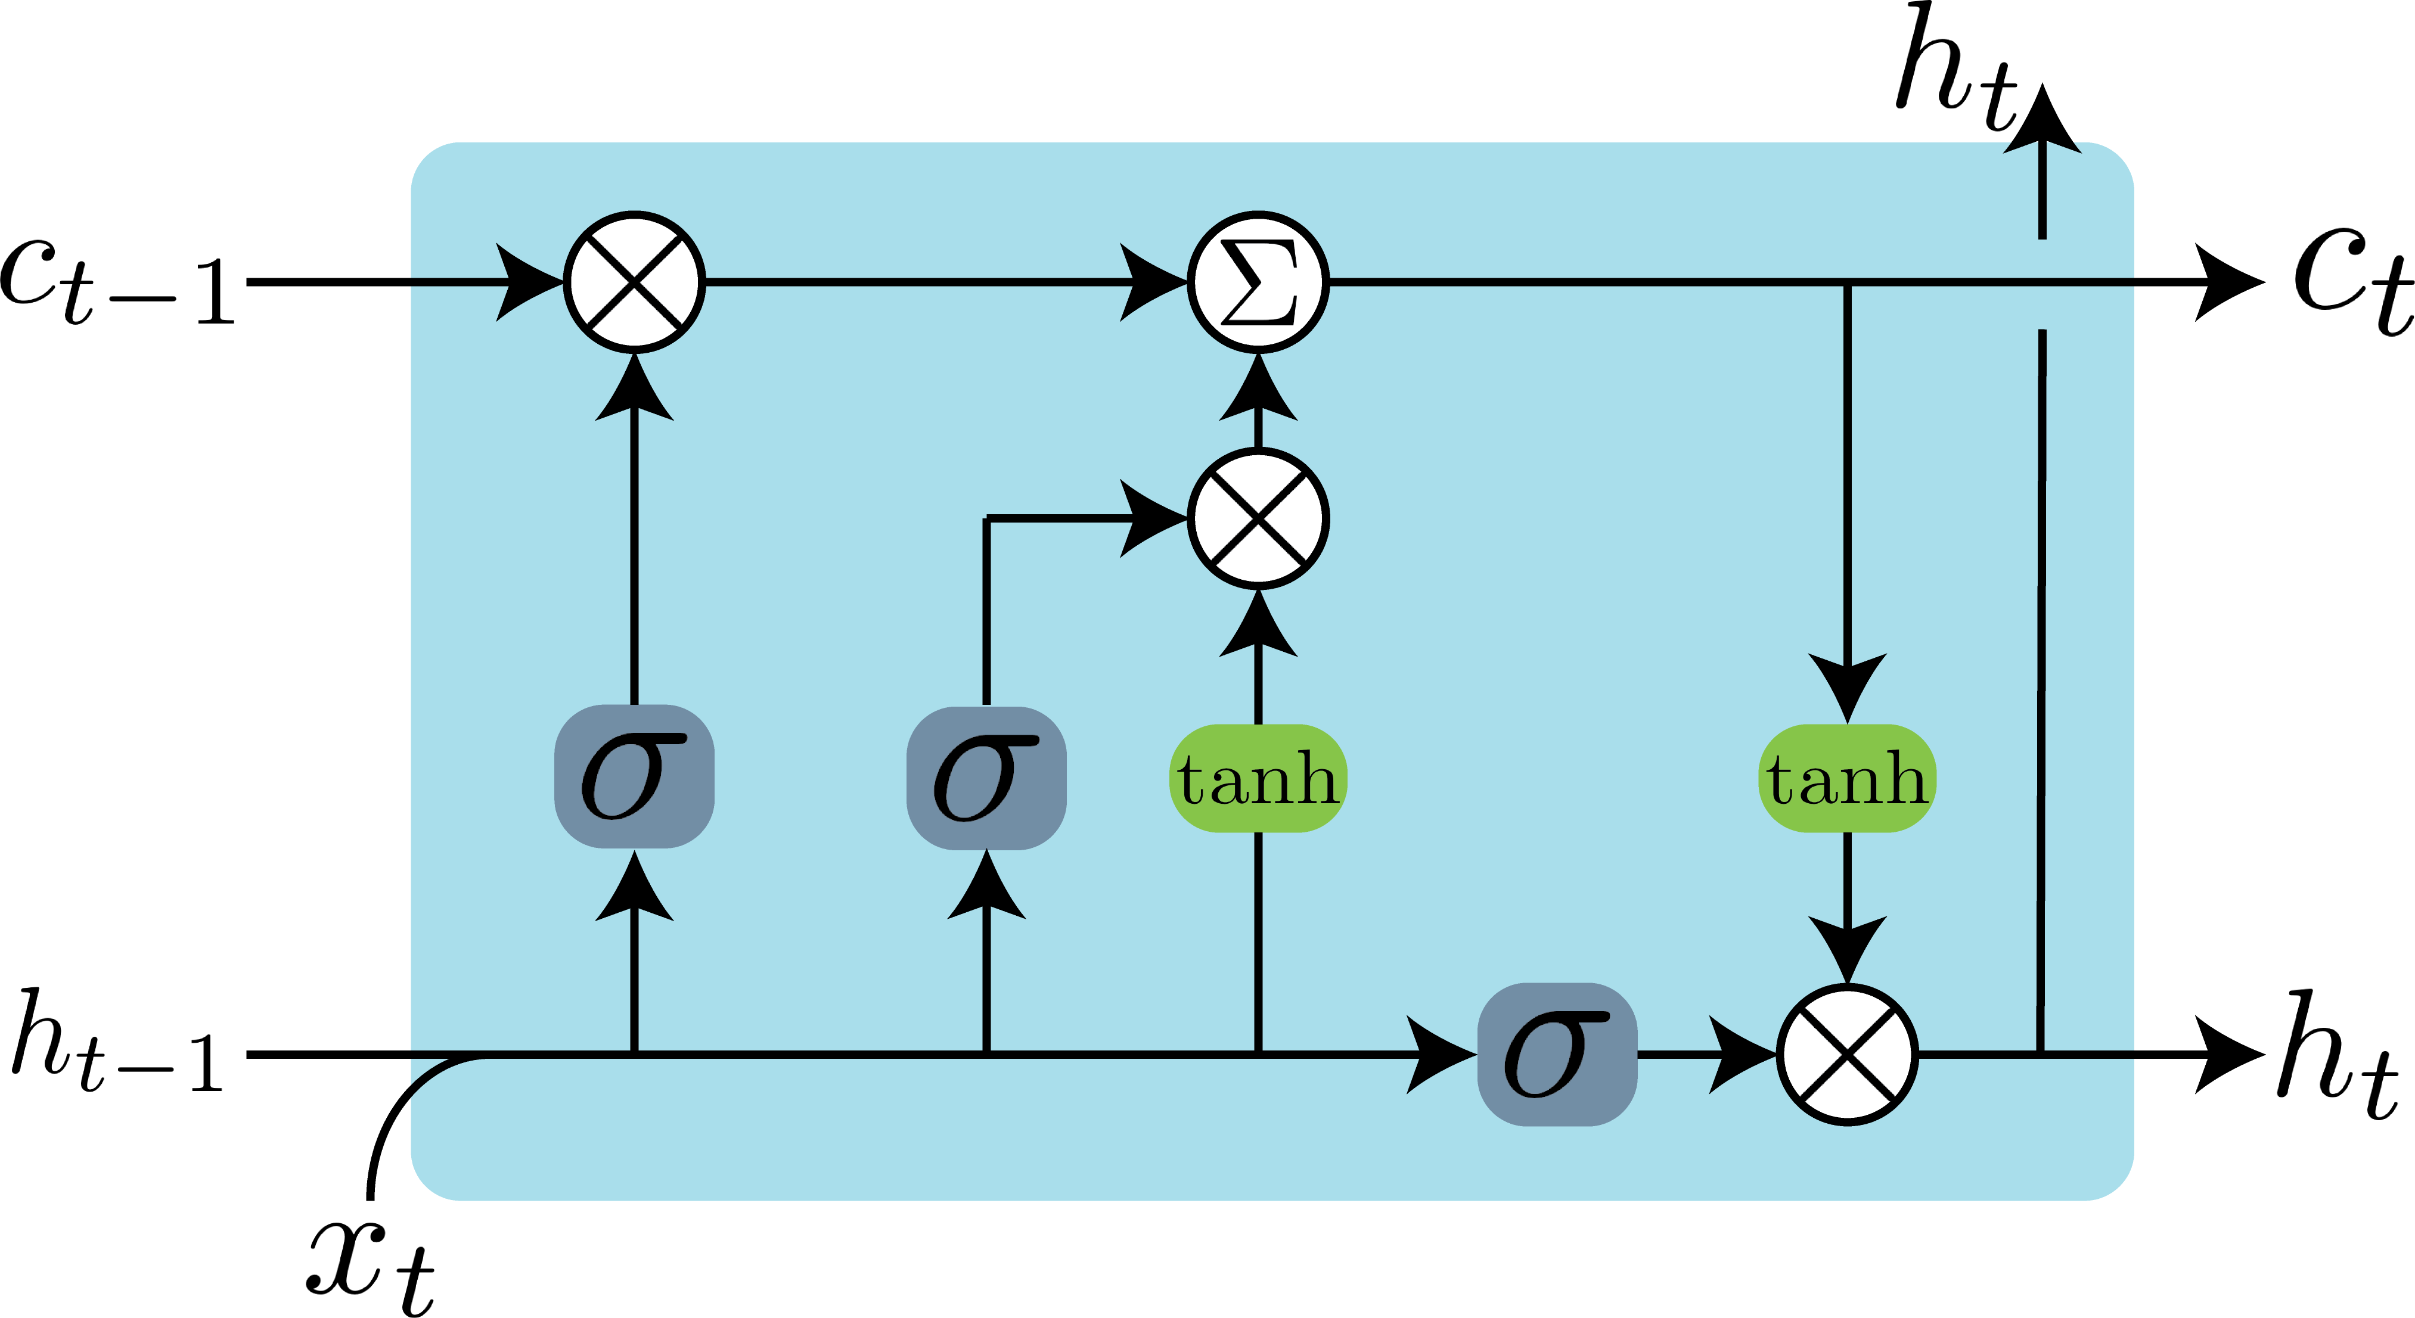
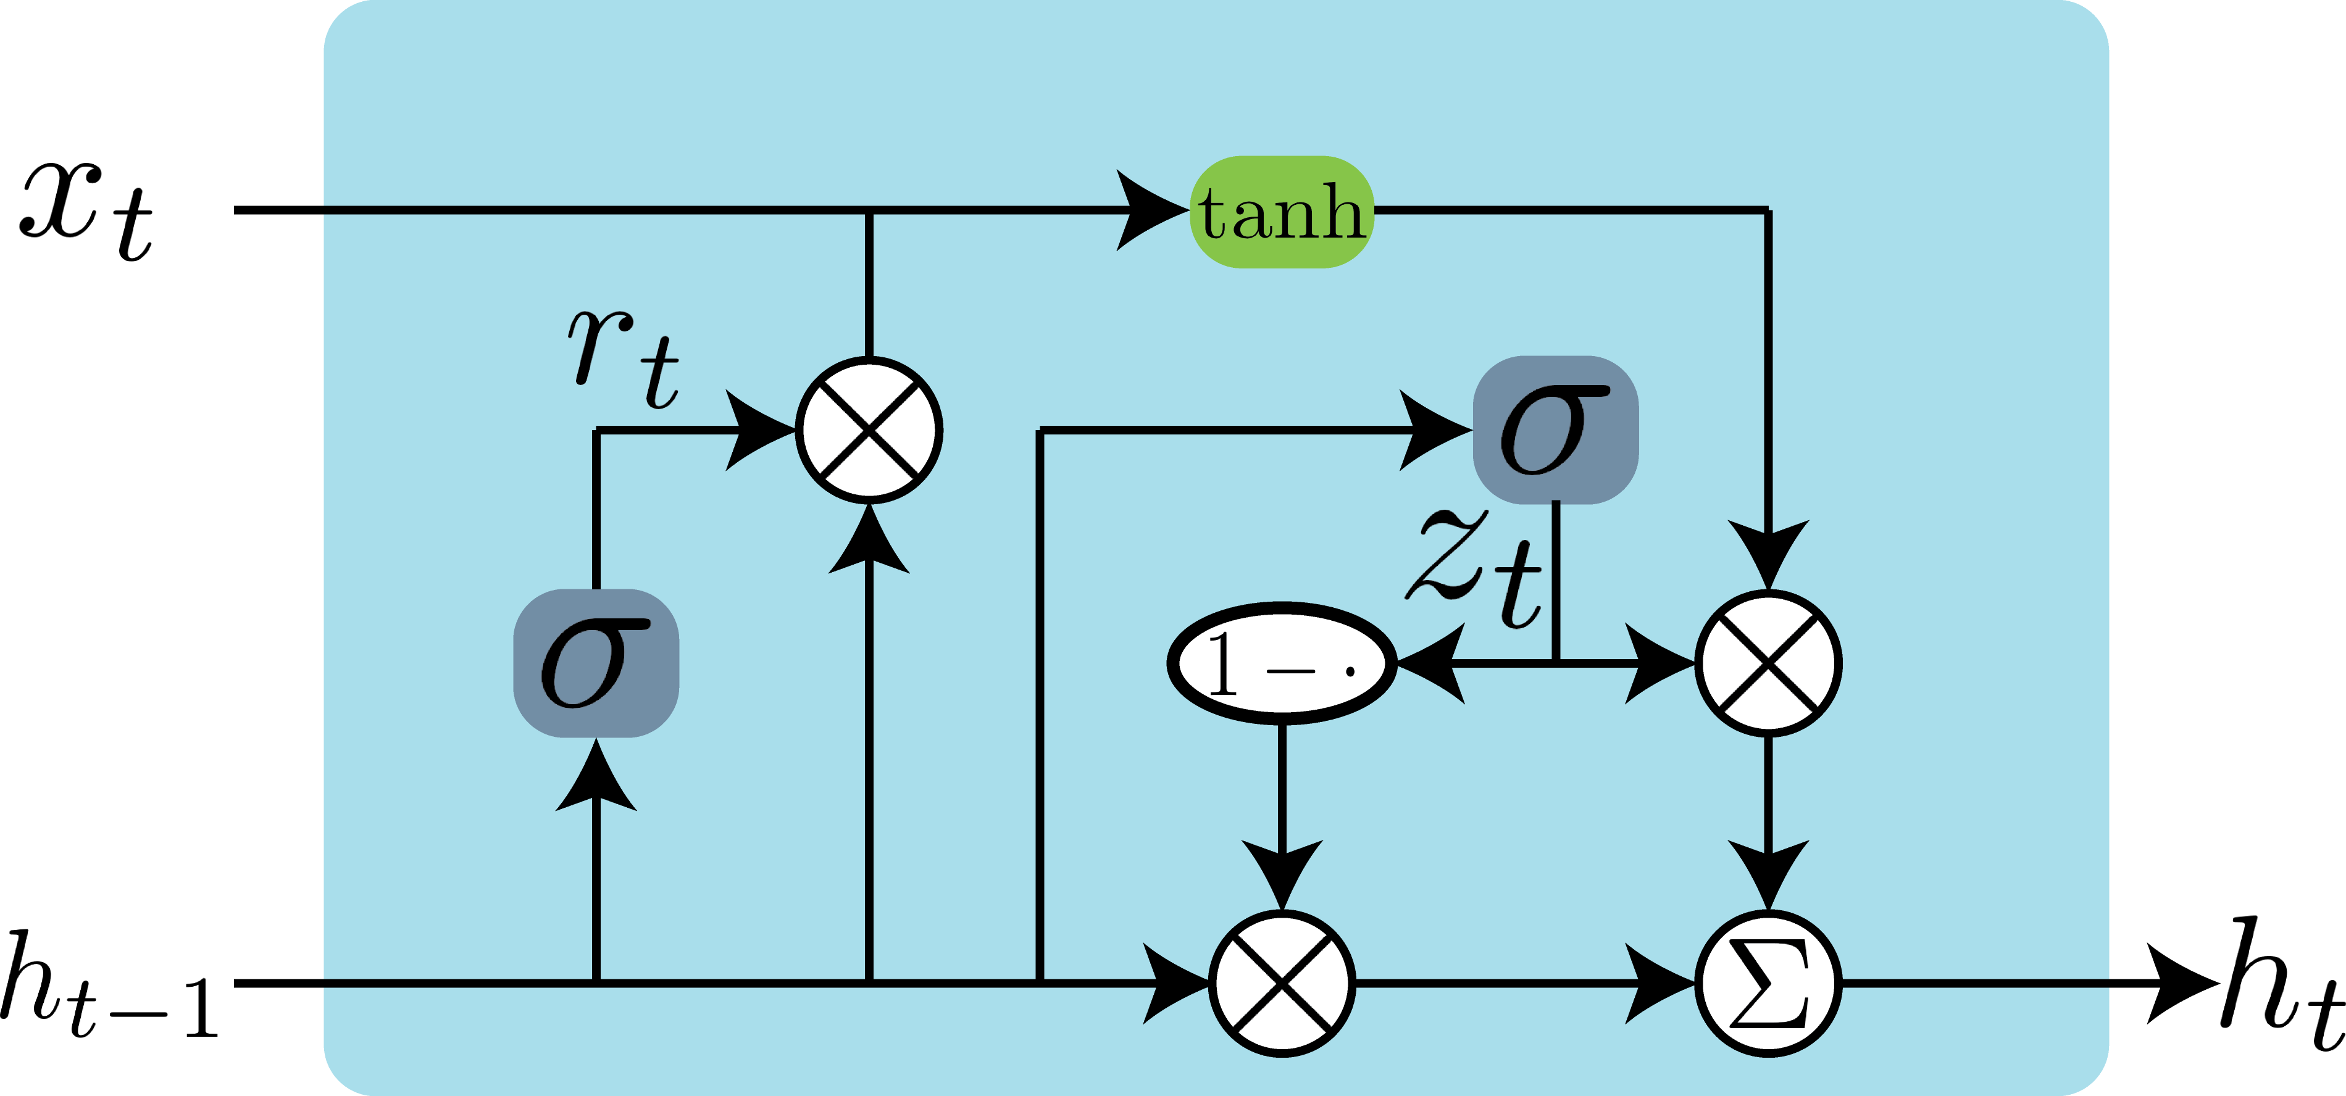



Speech Recognition – Deep Learning
Gated Recurrent Unit
Long Short-Term Memory
Cell State
Reset Gate
Update Gate
Input Gate
Output Gate
Forget Gate
Summation
Sigmoid
Multiplication
Hyperbolic Tangent

Slide 21
Outline
Speech Processing
Speech Recognition
Blind Source Separation
Speech Enhancement
Speaker Verification & Speaker Diarization
Deep Learning Theory
Stochastic Thermodynamics of Learning
Deep Relaxation
Analyzing Neural Networks via Information Theory
Residual Networks as a Mean-Field Optimal Control Problem

Slide 22
Outline
Speech Processing
Speech Recognition
Blind Source Separation
Speech Enhancement
Speaker Verification & Speaker Diarization
Deep Learning Theory
Stochastic Thermodynamics of Learning
Deep Relaxation
Analyzing Neural Networks via Information Theory
Residual Networks as a Mean-Field Optimal Control Problem

Slide 23
BSS – Independent Component Analysis

Slide 24
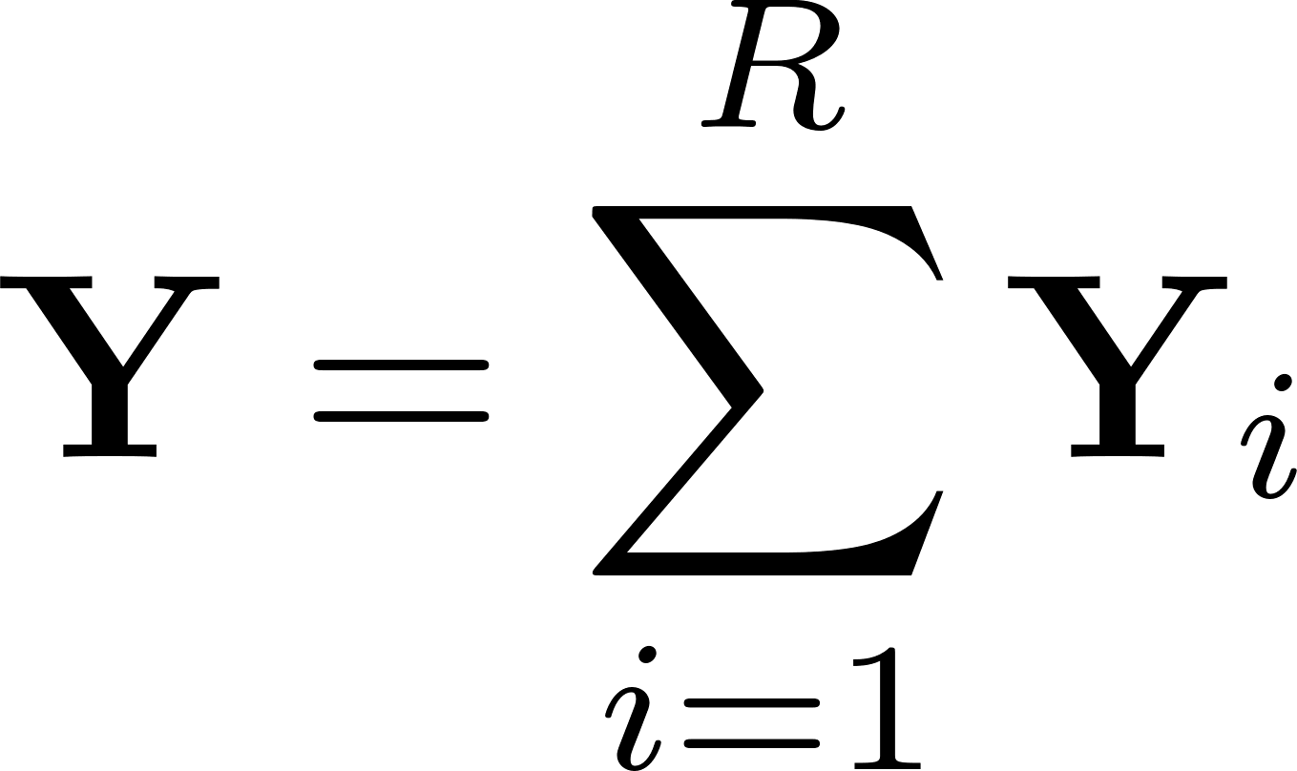


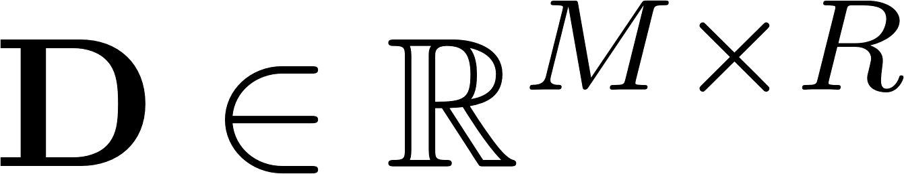
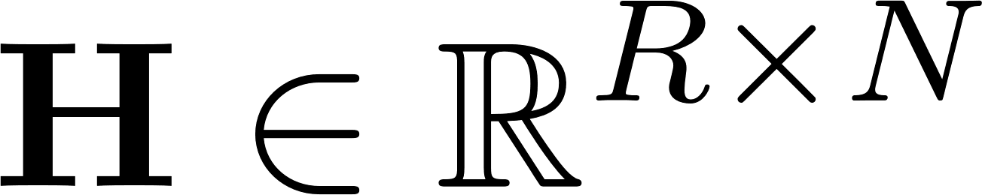


BSS – Non-negative Matrix Factorization
Summation of Sources
Mixed Signal
Dictionary Matrix
Code Matrix

Slide 25
BSS – Non-negative Matrix Factorization
Summation of Sources
Frequency
Mixed Signal
Dictionary Matrix
Code Matrix
Time
Features

Slide 26
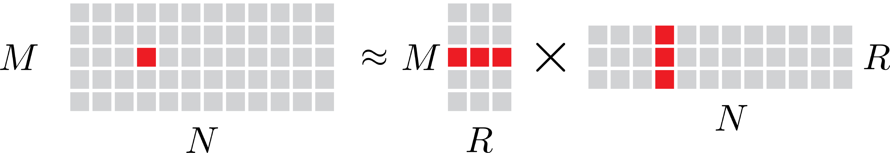
BSS – Non-negative Matrix Factorization

Slide 27

BSS – Non-negative Matrix Factorization

Slide 28
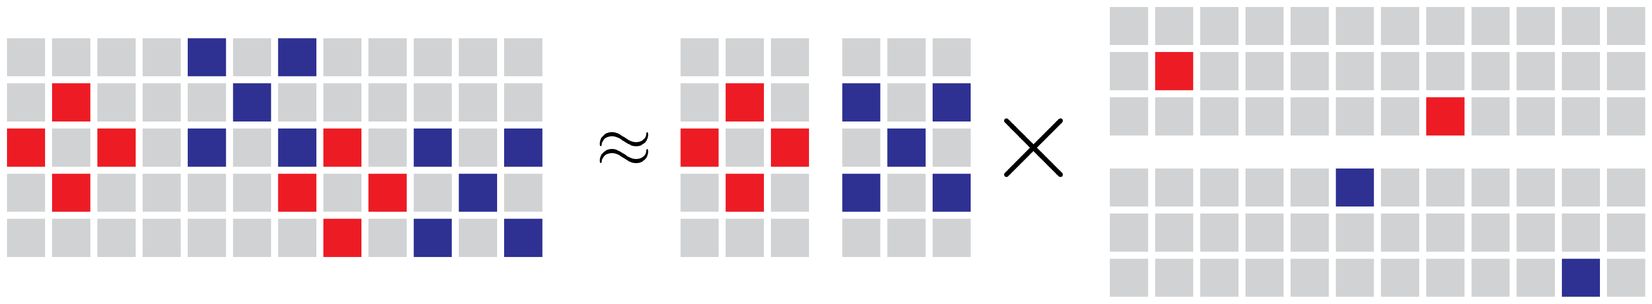
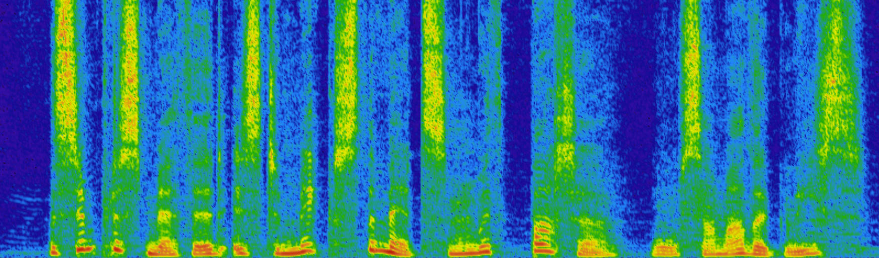
BSS – Non-negative Matrix Factorization

Slide 29
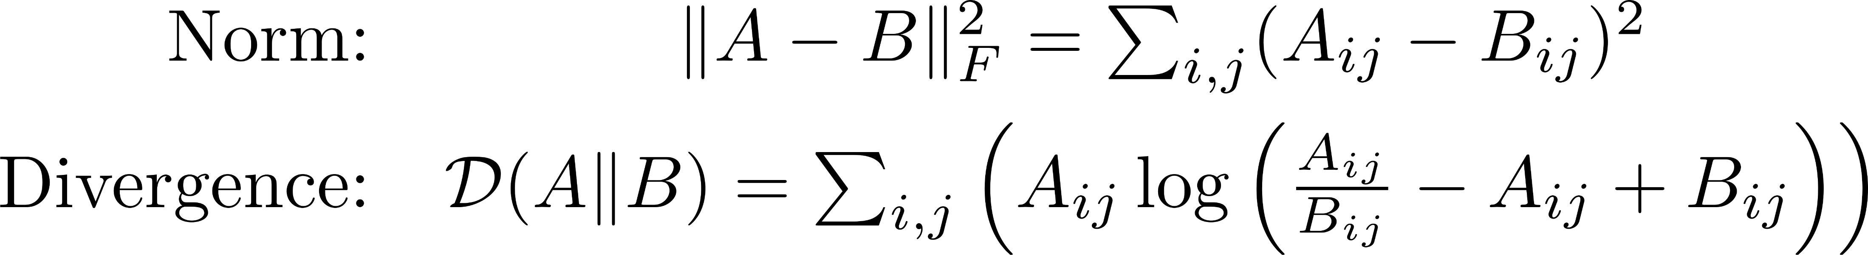
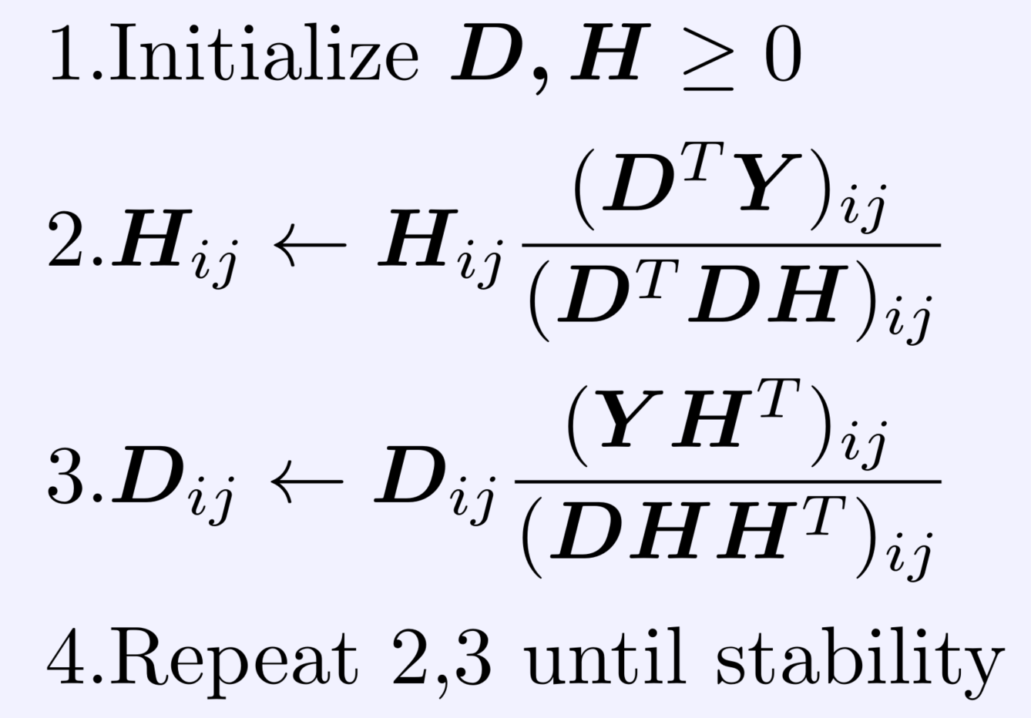
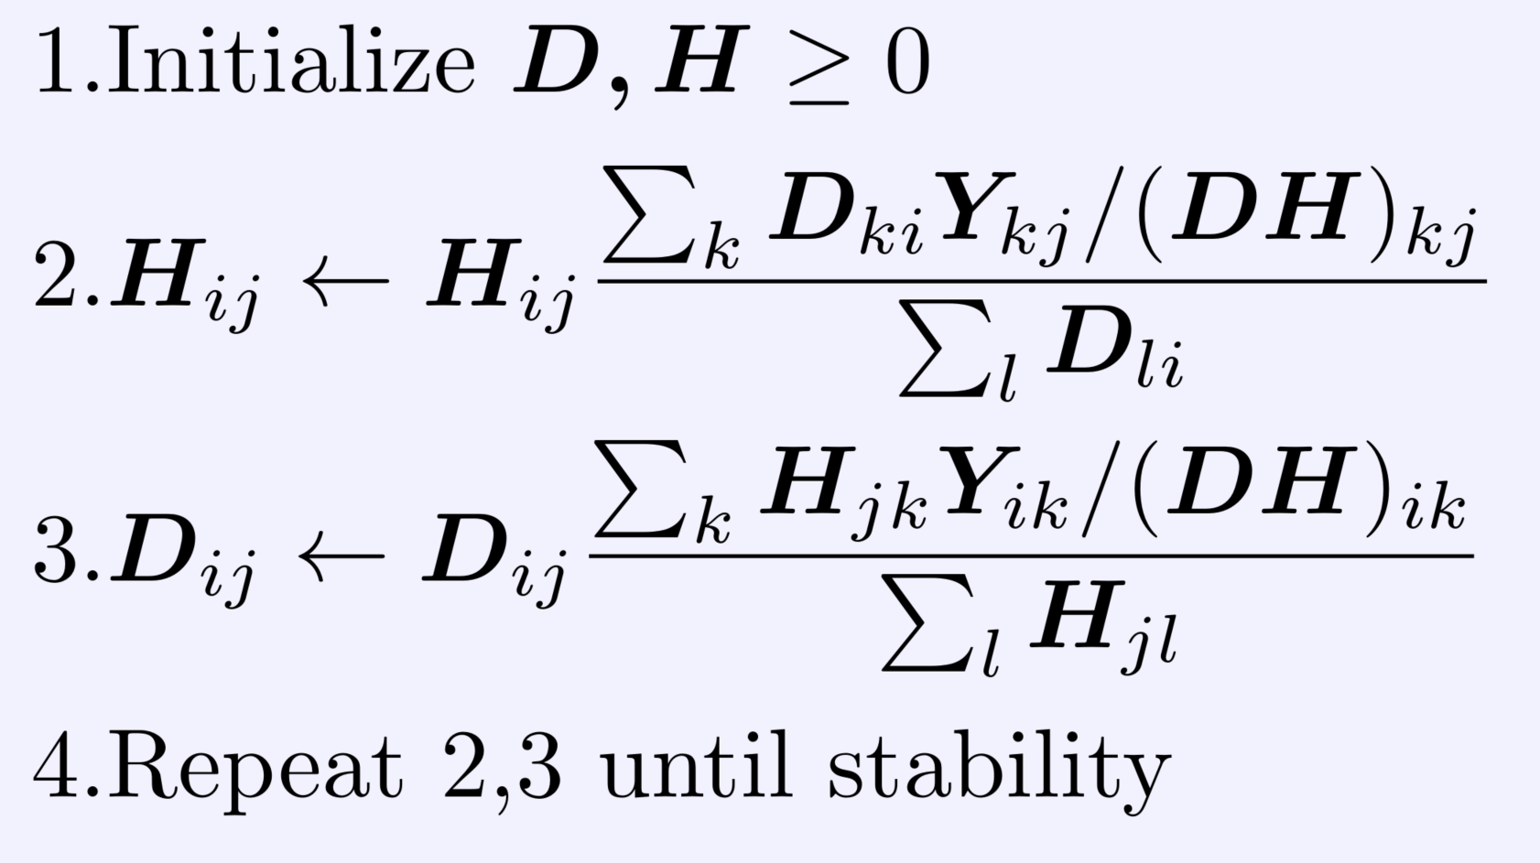
BSS – Non-negative Matrix Factorization
Alg for Norm Minimization
Alg for Divergence Minimization
Notes:
For the divergence, if Sum(i,j) Aij = Sum(i,j) Bij = 1, then it becomes the KL Divergence

Slide 30

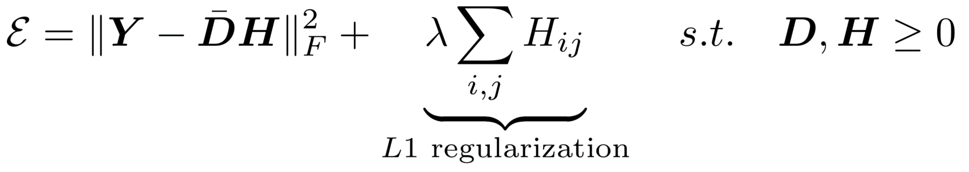

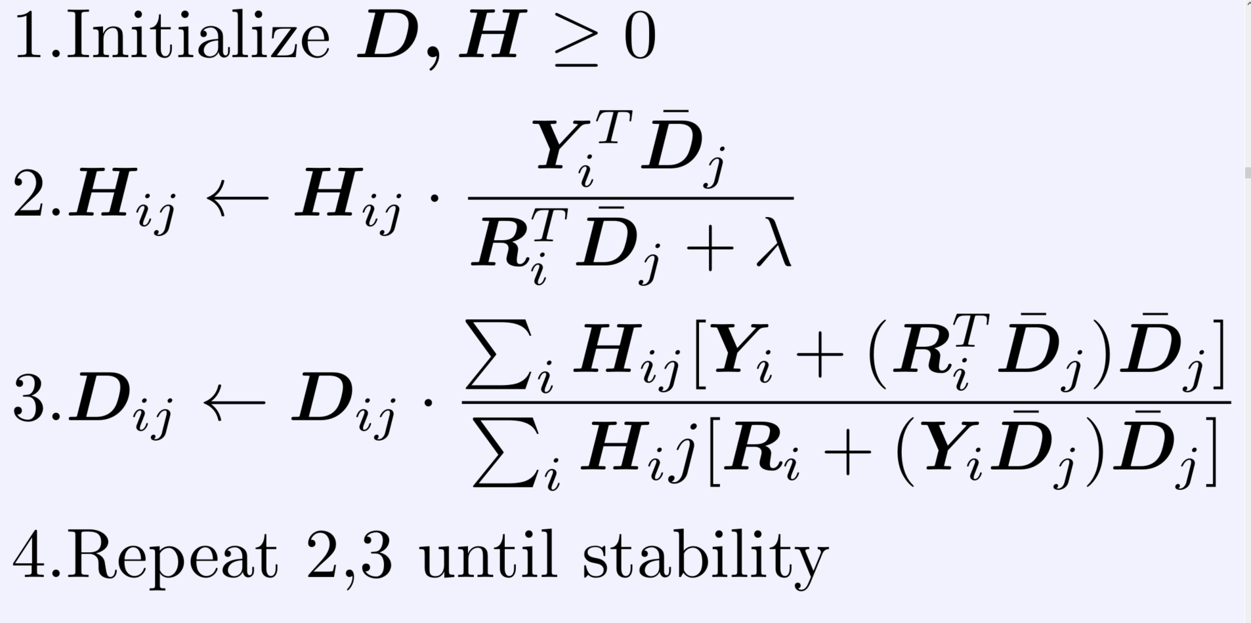
BSS – Non-negative Matrix Factorization
Sparse Non-negative Matrix Fact.
Alg for Norm Minimization
Alg for Norm Min. w/ Regularizer
Notes:
For the divergence, if Sum(i,j) Aij = Sum(i,j) Bij = 1, then it becomes the KL Divergence

Slide 31
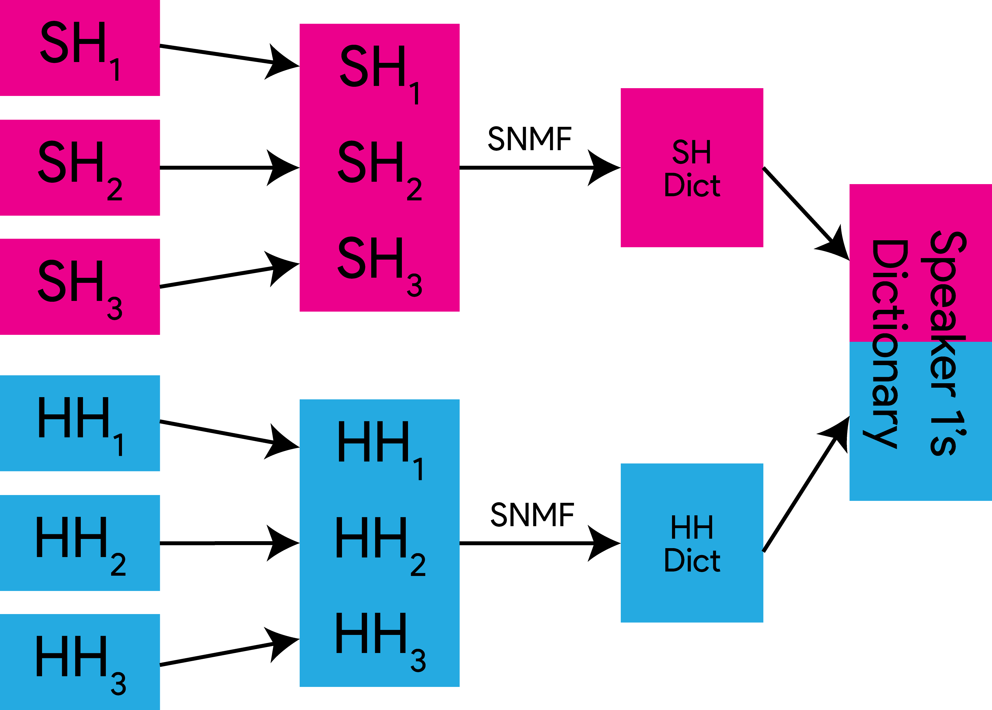
BSS – Sparse Non-negative Matrix Fact.
Schmidt and Olson, 2006

Slide 32
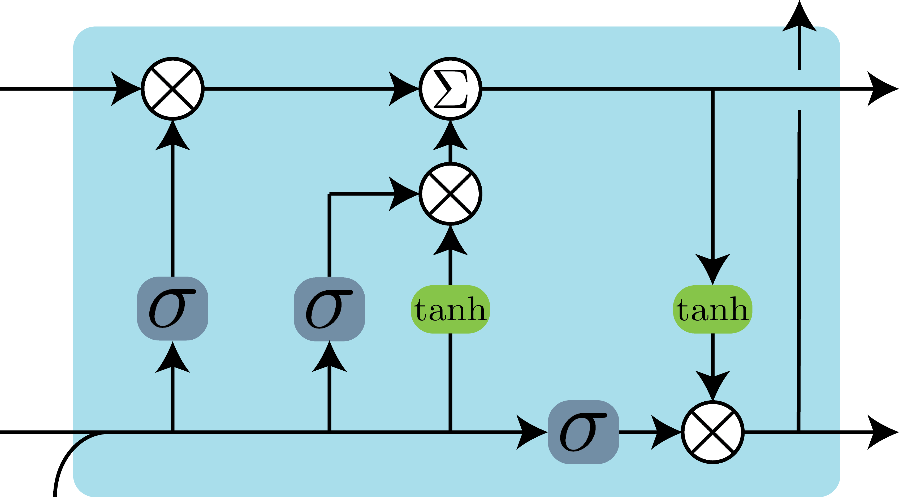
BSS – Recurrent Neural Networks

Slide 33
BSS – Recurrent Neural Networks

Slide 34
Outline
Speech Processing
Speech Recognition
Blind Source Separation
Speech Enhancement
Speaker Verification & Speaker Diarization
Deep Learning Theory
Stochastic Thermodynamics of Learning
Deep Relaxation
Analyzing Neural Networks via Information Theory
Residual Networks as a Mean-Field Optimal Control Problem

Slide 35
Outline
Speech Processing
Speech Recognition
Blind Source Separation
Speech Enhancement
Speaker Verification & Speaker Diarization
Deep Learning Theory
Stochastic Thermodynamics of Learning
Deep Relaxation
Analyzing Neural Networks via Information Theory
Residual Networks as a Mean-Field Optimal Control Problem

Slide 36
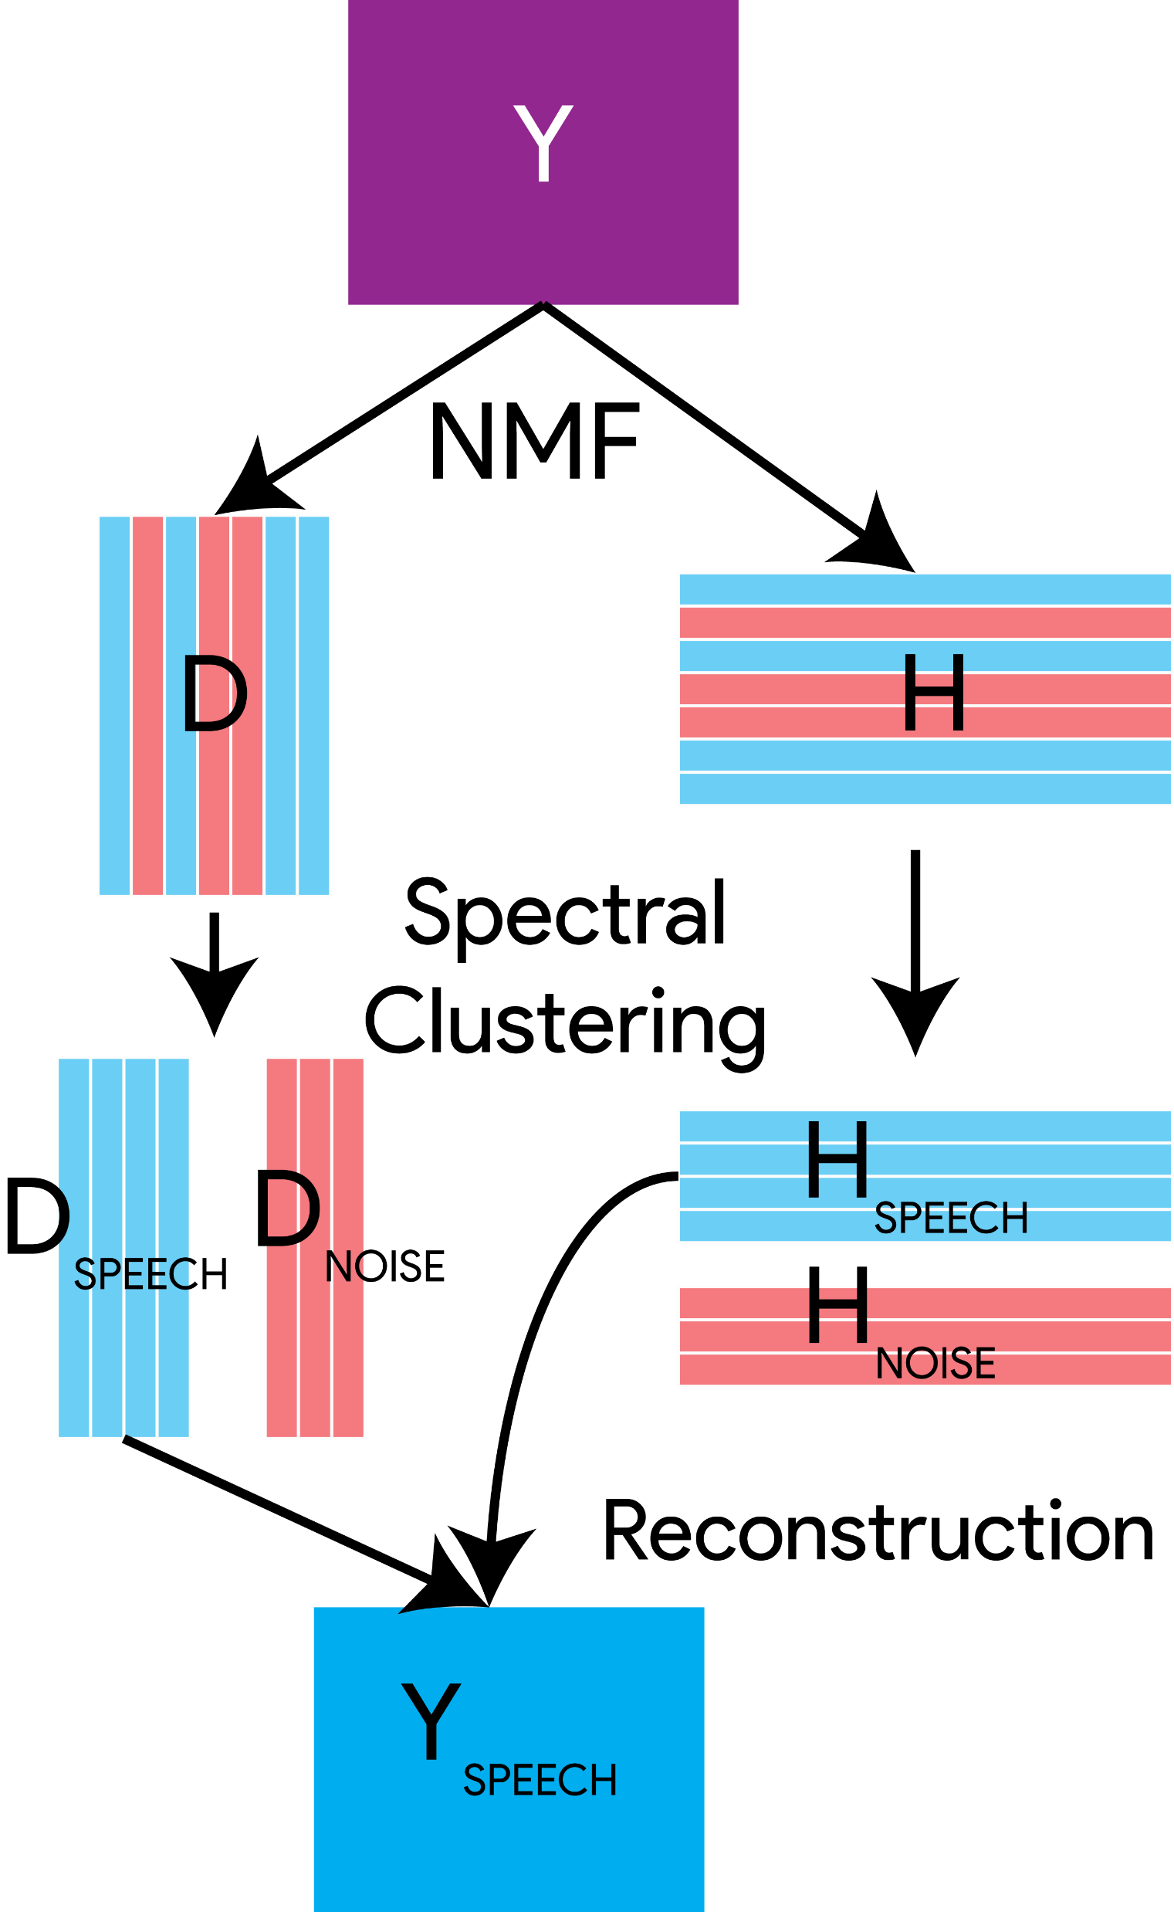
Speech Enhancement – Non-neg. Matrix Fact.

Slide 37
Outline
Speech Processing
Speech Recognition
Blind Source Separation
Speech Enhancement
Speaker Verification & Speaker Diarization
Deep Learning Theory
Stochastic Thermodynamics of Learning
Deep Relaxation
Analyzing Neural Networks via Information Theory
Residual Networks as a Mean-Field Optimal Control Problem

Slide 38
Outline
Speech Processing
Speech Recognition
Blind Source Separation
Speech Enhancement
Speaker Verification & Speaker Diarization
Deep Learning Theory
Stochastic Thermodynamics of Learning
Deep Relaxation
Analyzing Neural Networks via Information Theory
Residual Networks as a Mean-Field Optimal Control Problem

Slide 39
Verification & Diarization
Universal Background Model (UBM)
Eigenvoices &
Eigenchannels
Joint Factor
Analysis
i-Vectors

Slide 40
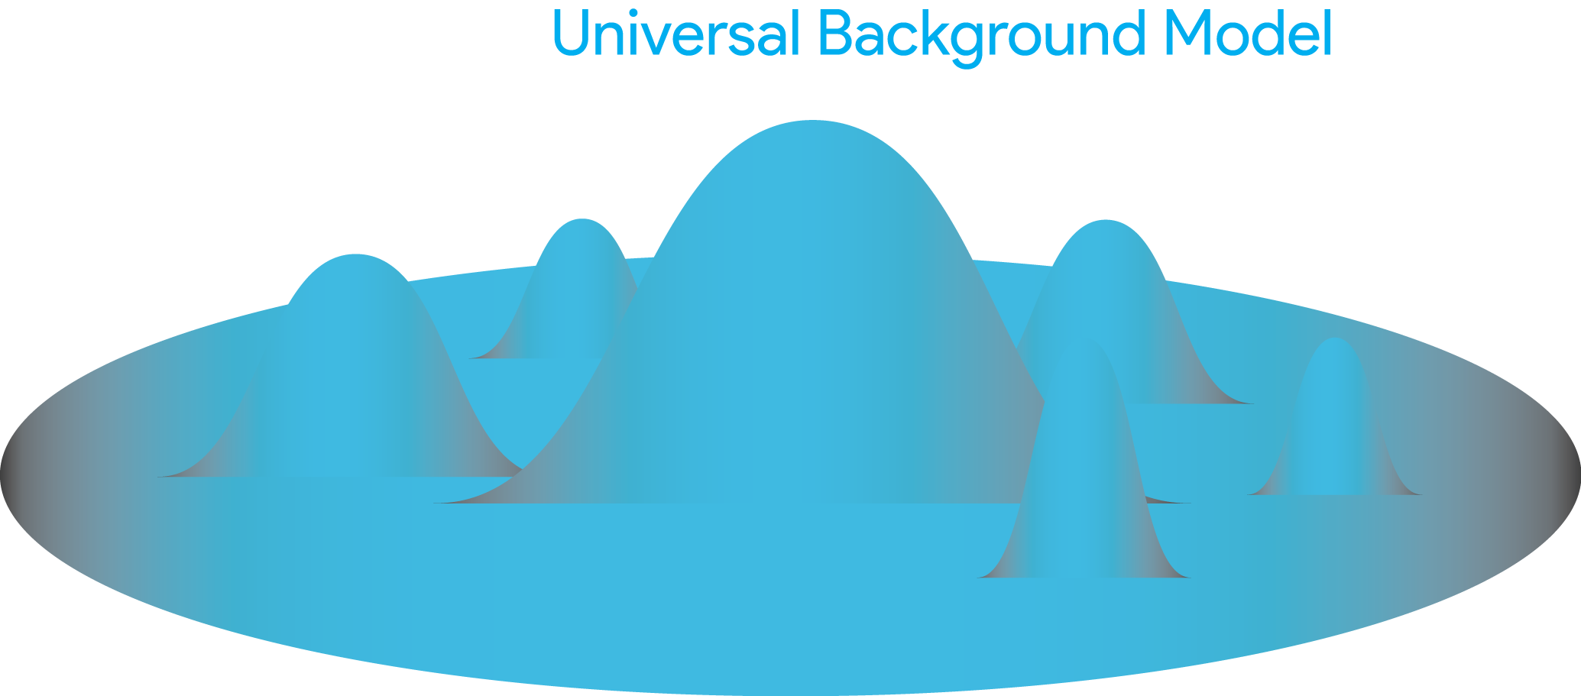
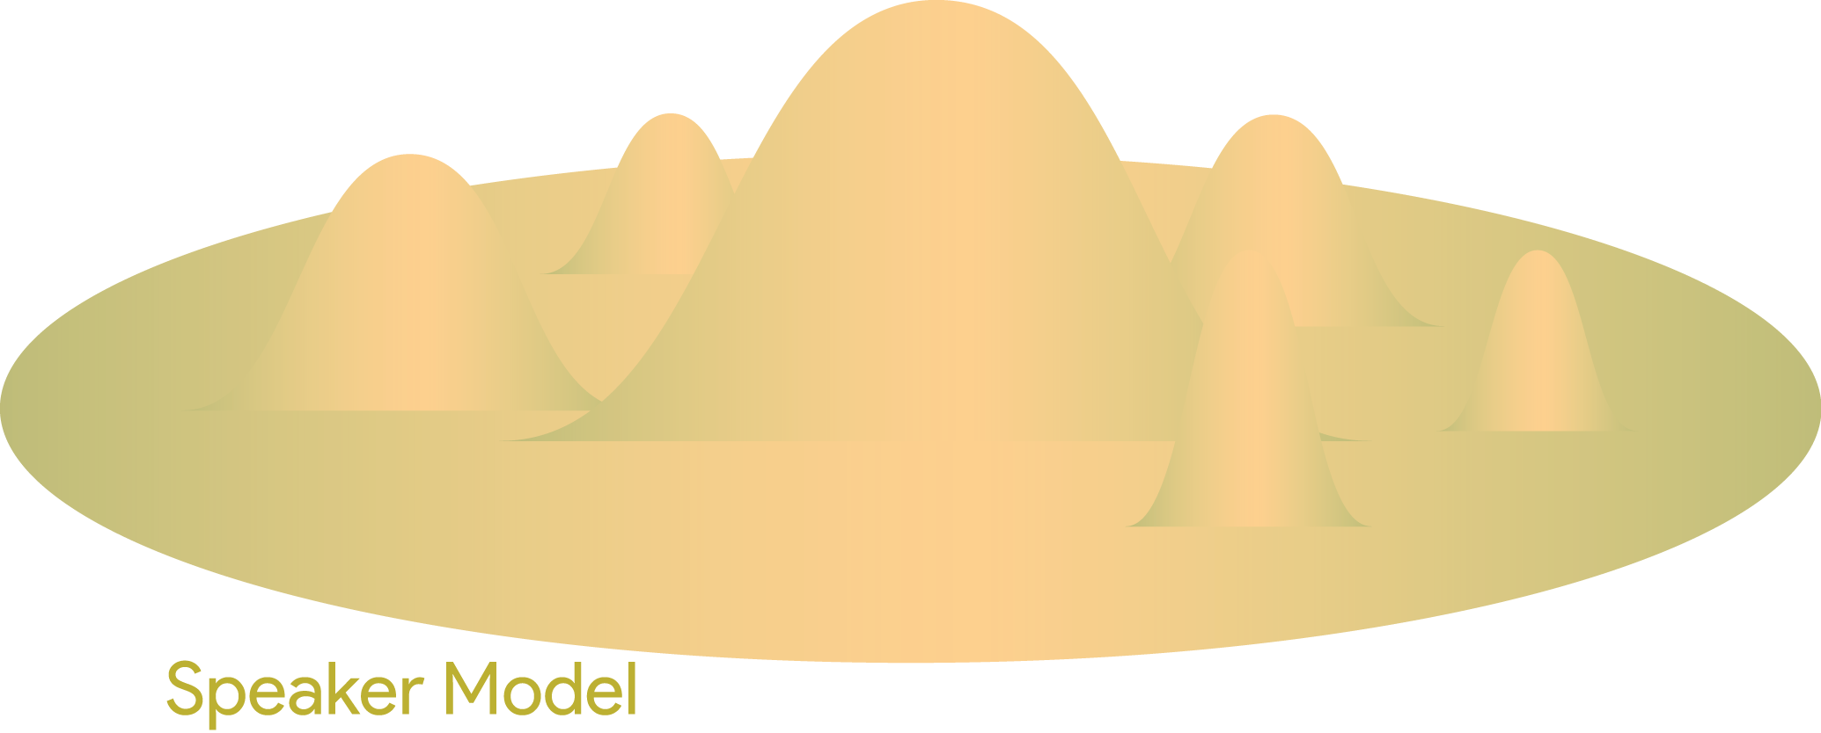
Verification & Diarization - UBM

Slide 41
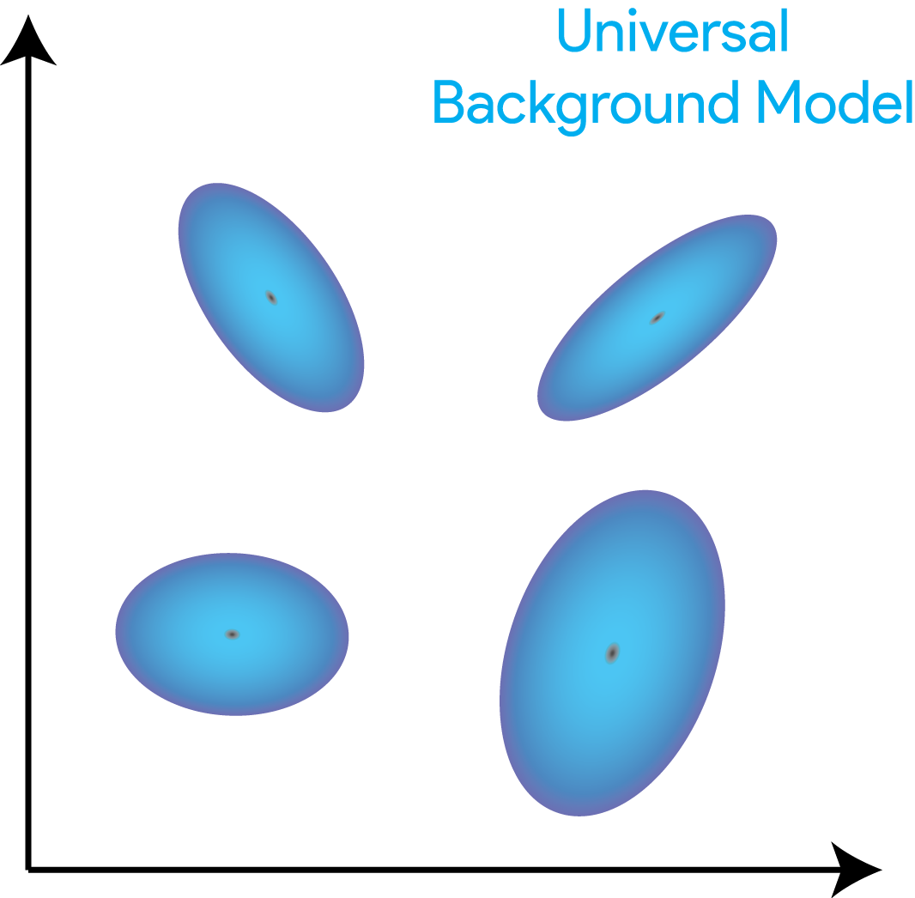
Verification & Diarization - UBM

Slide 42
Verification & Diarization - UBM

Slide 43
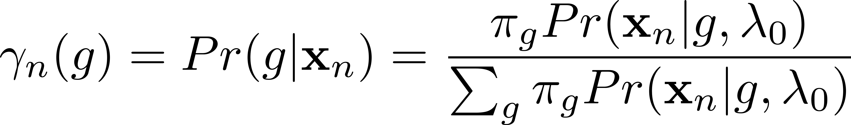
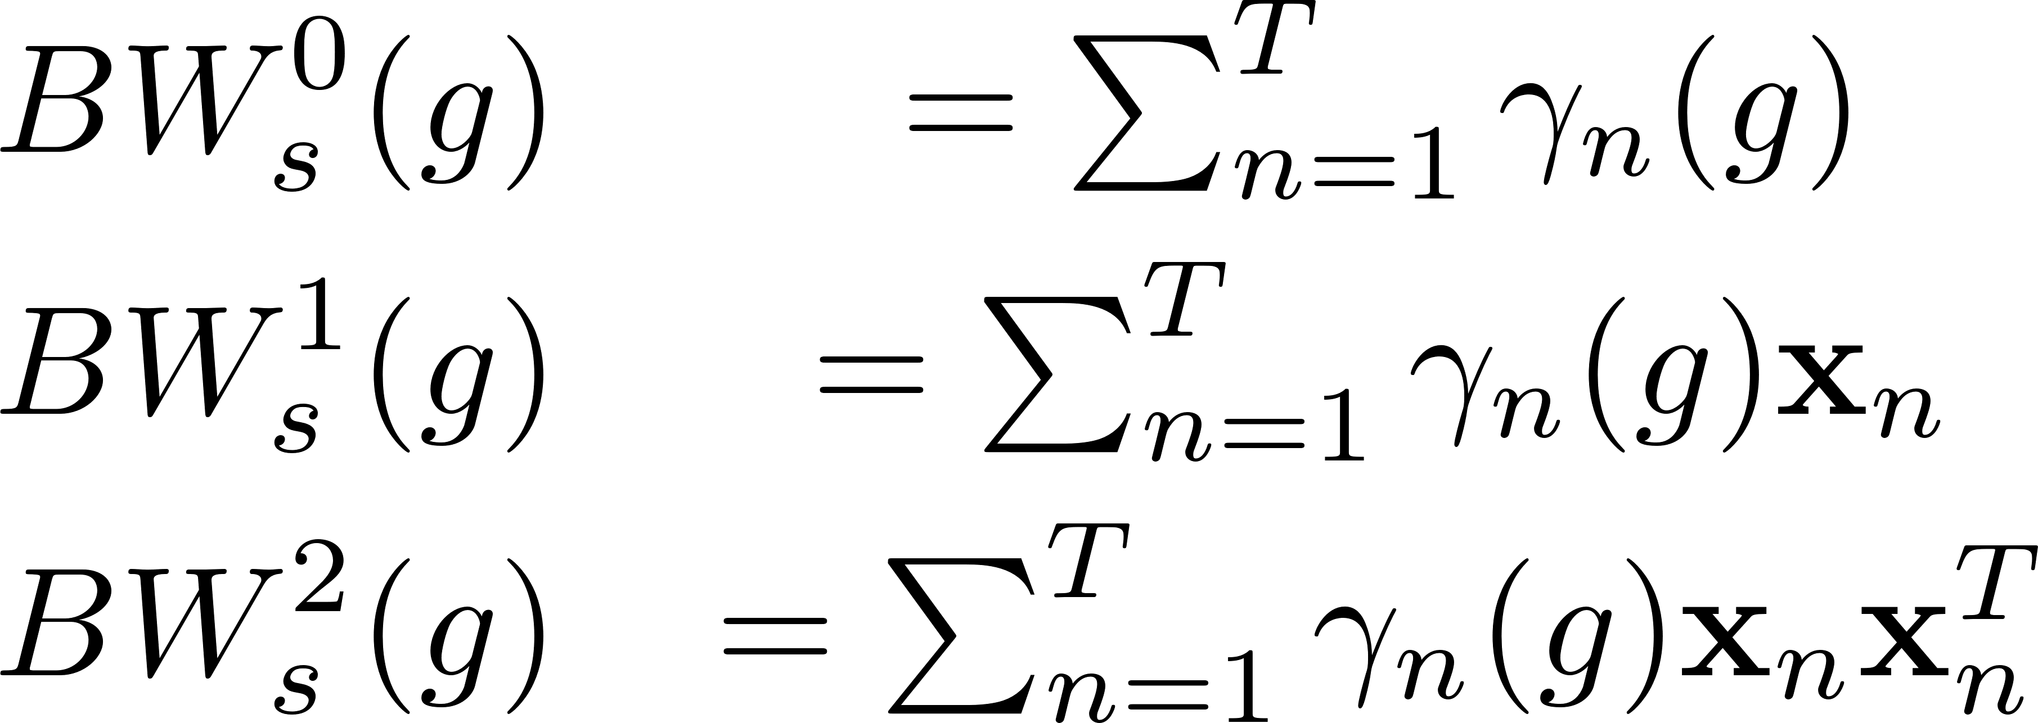
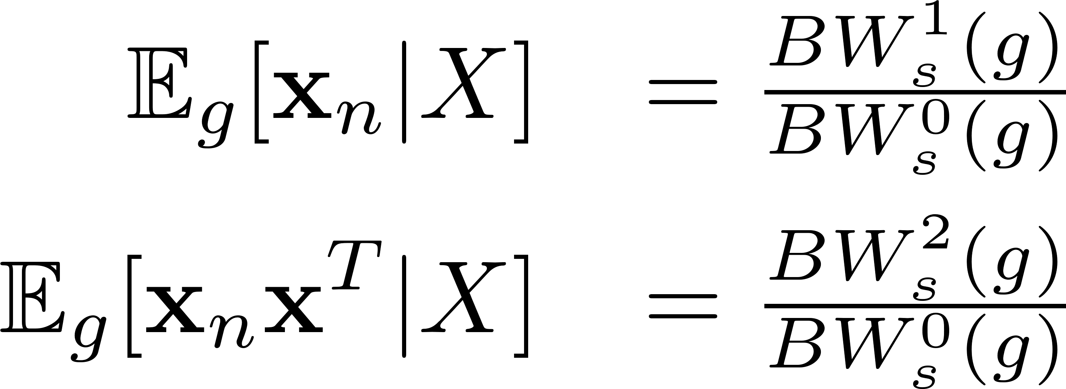
Verification & Diarization - UBM
Probability Weight of Gaussians
Baum-Welch
Statistics
Posterior Mean and Posterior Covariance

Slide 44
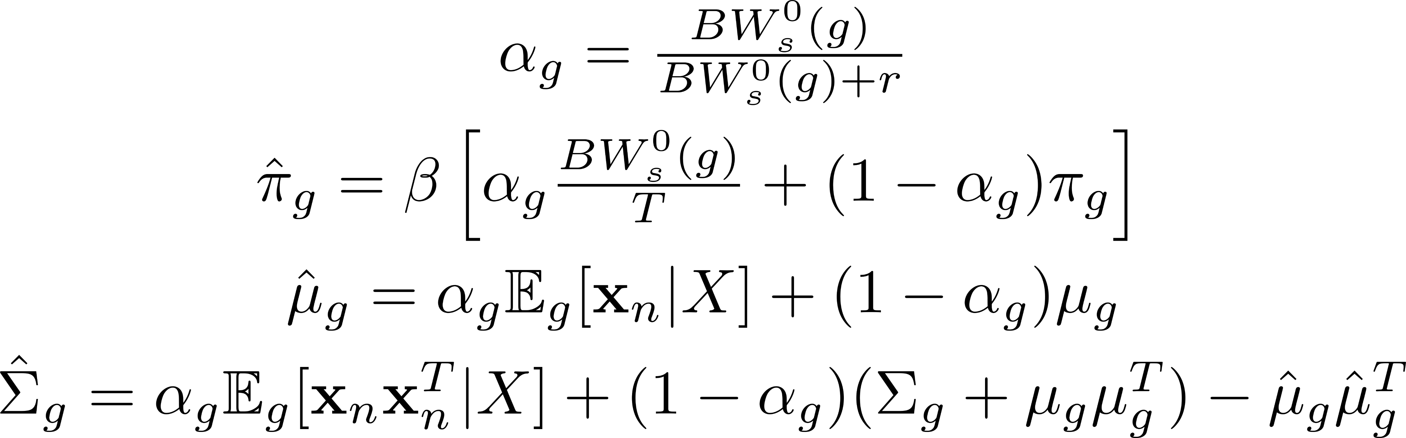
Verification & Diarization - UBM
Posterior Mean and Posterior Covariance

Slide 45
Verification & Diarization - UBM

Slide 46
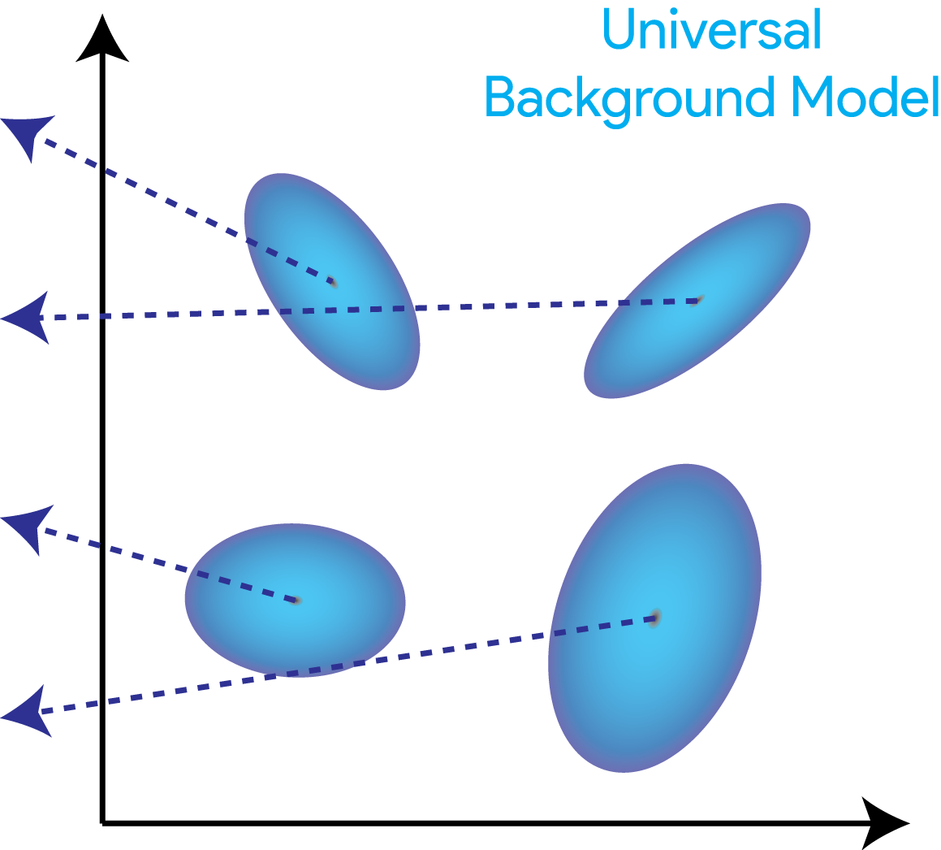
Verification & Diarization - UBM

Slide 47
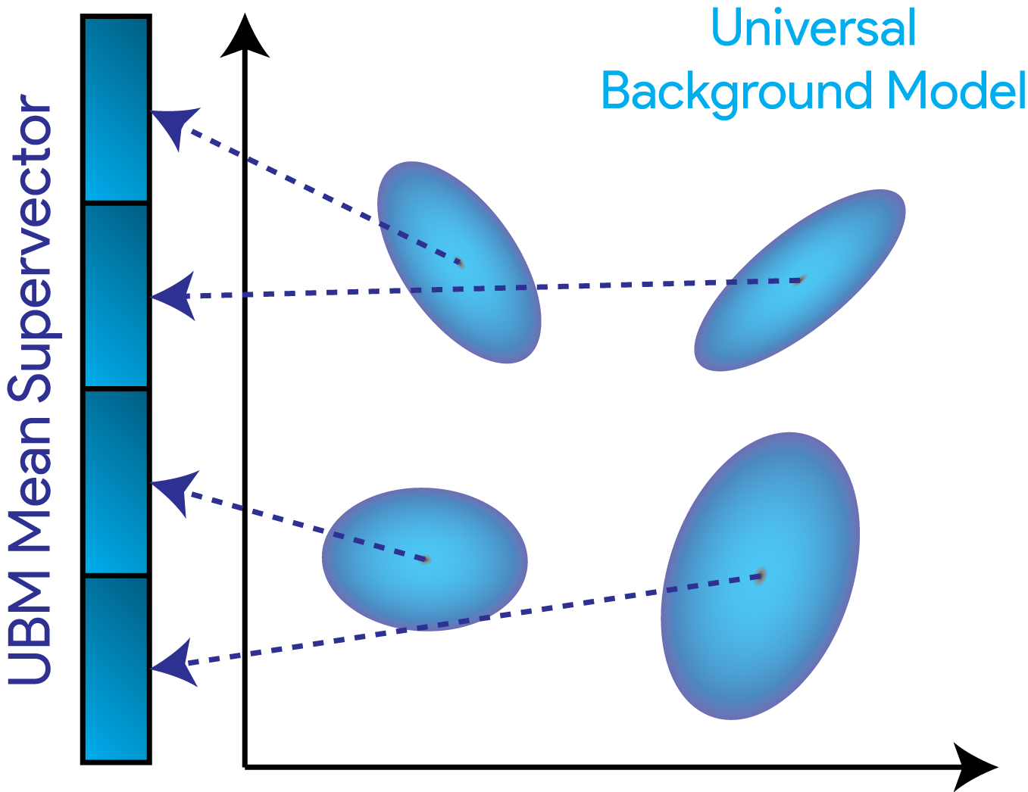
Verification & Diarization - UBM

Slide 48
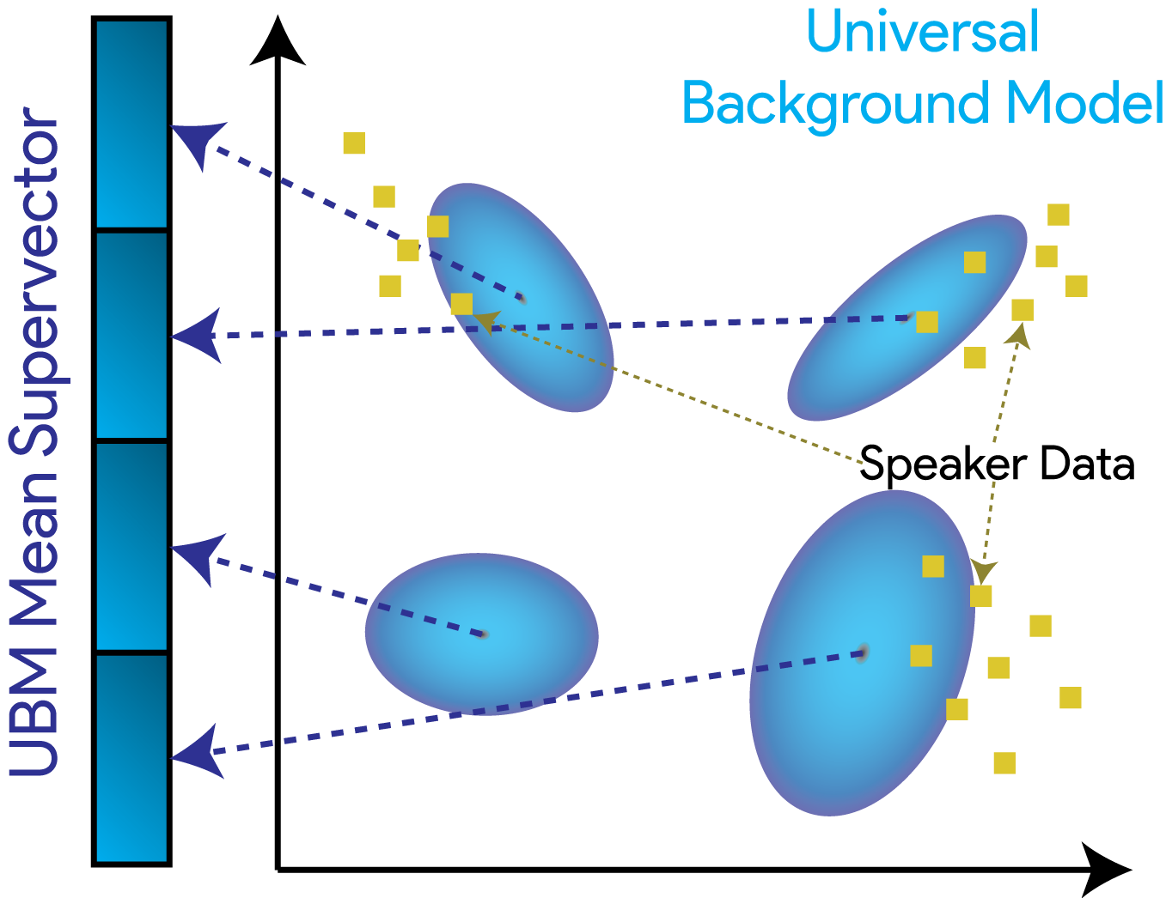
Verification & Diarization - UBM

Slide 49
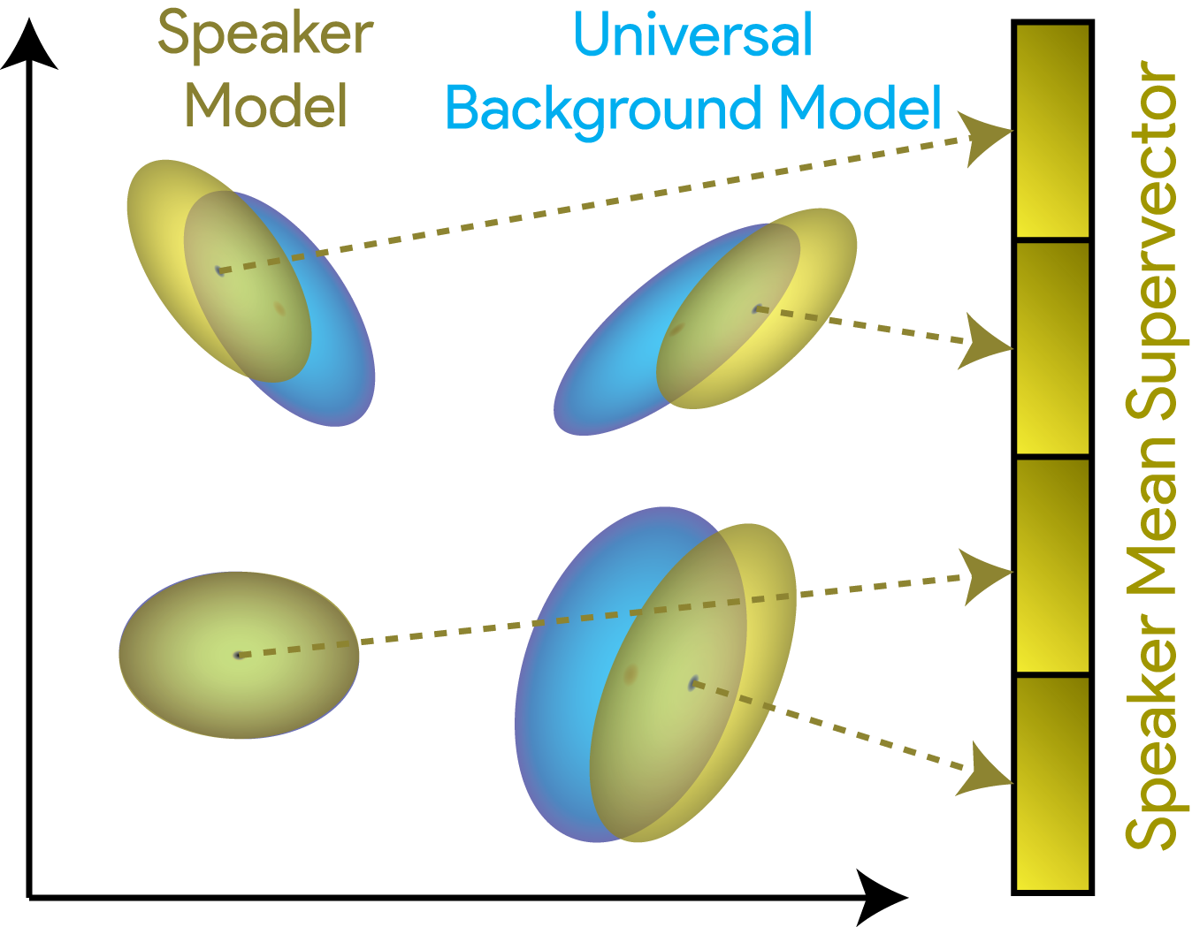
Verification & Diarization - UBM

Slide 50
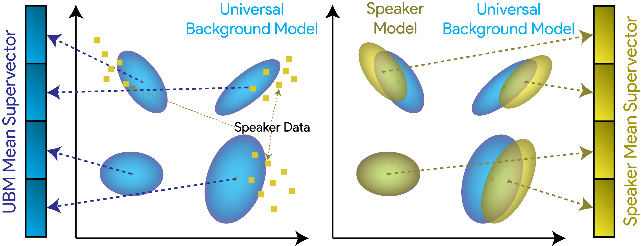
Verification & Diarization - UBM

Slide 51
Verification & Diarization
Universal Background Model (UBM)
Eigenvoices &
Eigenchannels
Joint Factor
Analysis
i-Vectors

Slide 52
Verification & Diarization - Generalized

Slide 53
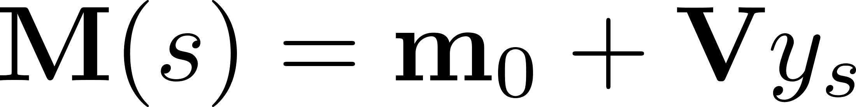

Verification & Diarization – Eigenvoices

Slide 54
Verification & Diarization – Eigenvoices

Slide 55
Verification & Diarization – Eigen…

Slide 56
Verification & Diarization
Universal Background Model (UBM)
Eigenvoices &
Eigenchannels
Joint Factor
Analysis
i-Vectors

Slide 57
Verification & Diarization – Joint Factor Analysis

Slide 58
Verification & Diarization – Joint Factor Analysis
1. Train the U Matrix
2. Train the V matrix given the estimated U
3. Train the D matrix given the estimated U & V

Slide 59
Verification & Diarization
Universal Background Model (UBM)
Eigenvoices &
Eigenchannels
Joint Factor
Analysis
i-Vectors

Slide 60

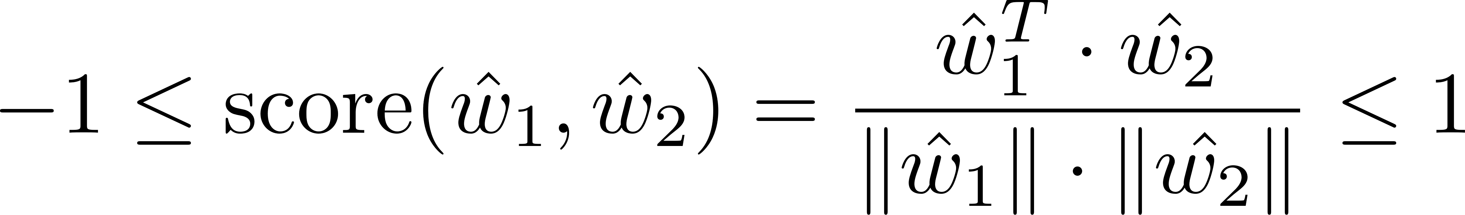
Verification & Diarization – i-Vectors
Train the T Matrix the same was as V, but treat all training speakers as belonging to different speakers
With T, compute the i-vectors w_{s} for each conversation side
For the channel compensation, perform a linear discriminant analysis, followed by a within-class covariance normalization
Perform a cosine distance scoring to the i-vectors for a pair of conversation sides

Slide 61
Outline
Speech Processing
Speech Recognition
Blind Source Separation
Speech Enhancement
Speaker Verification & Speaker Diarization
Deep Learning Theory
Stochastic Thermodynamics of Learning
Deep Relaxation
Analyzing Neural Networks via Information Theory
Residual Networks as a Mean-Field Optimal Control Problem

Slide 62
Outline
Speech Processing
Speech Recognition
Blind Source Separation
Speech Enhancement
Speaker Verification & Speaker Diarization
Deep Learning Theory
Stochastic Thermodynamics of Learning
Deep Relaxation
Analyzing Neural Networks via Information Theory
Residual Networks as a Mean-Field Optimal Control Problem

Slide 63
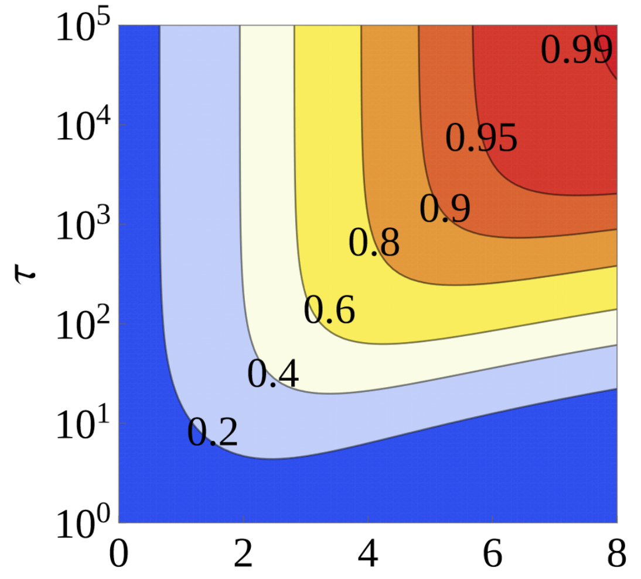
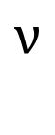
Thermodynamics of Learning
$$ν$$
Notes:
A^p generates the predicted output
k+- = rates

Slide 64
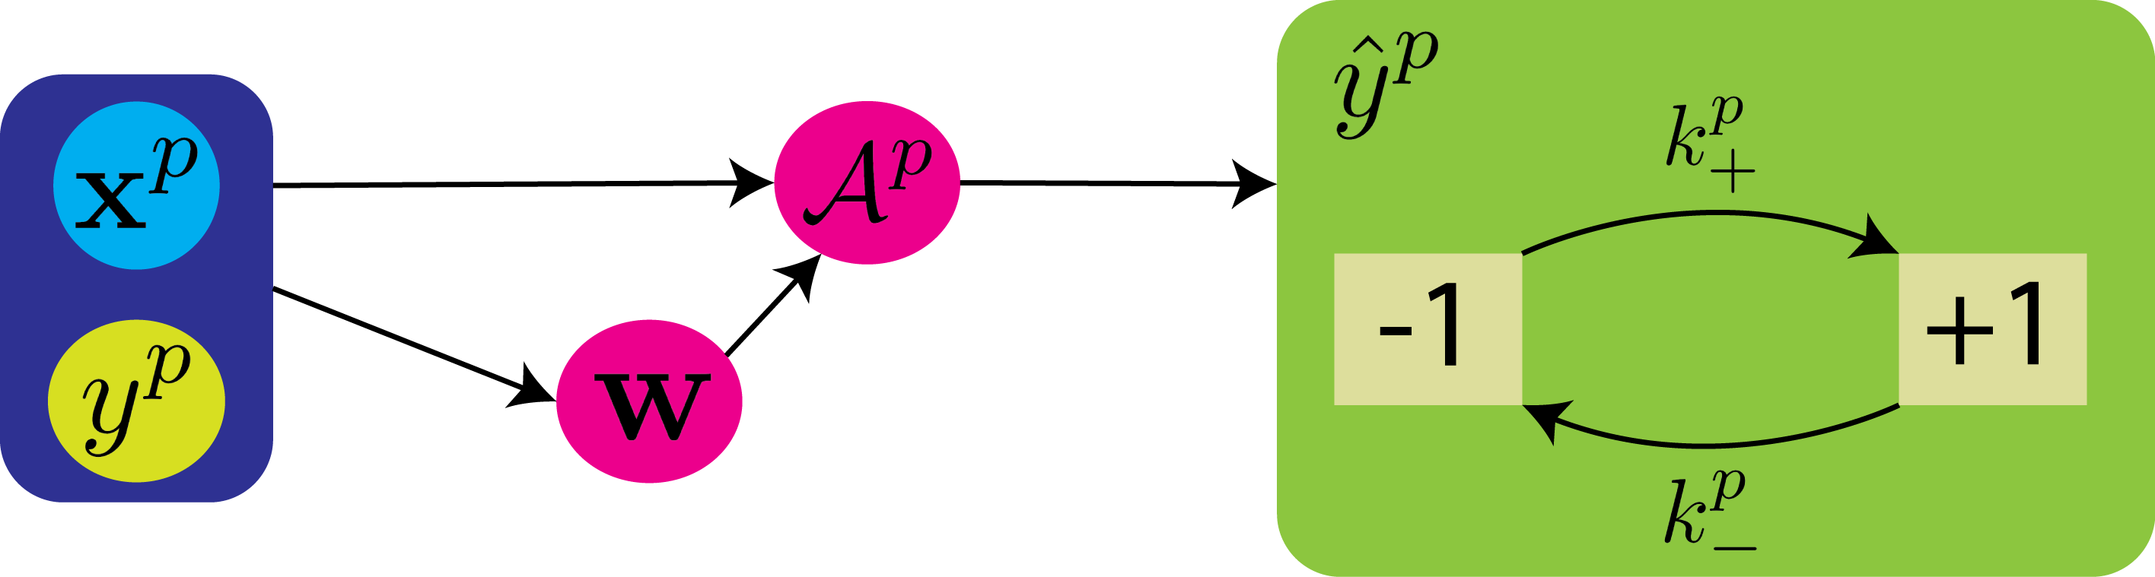
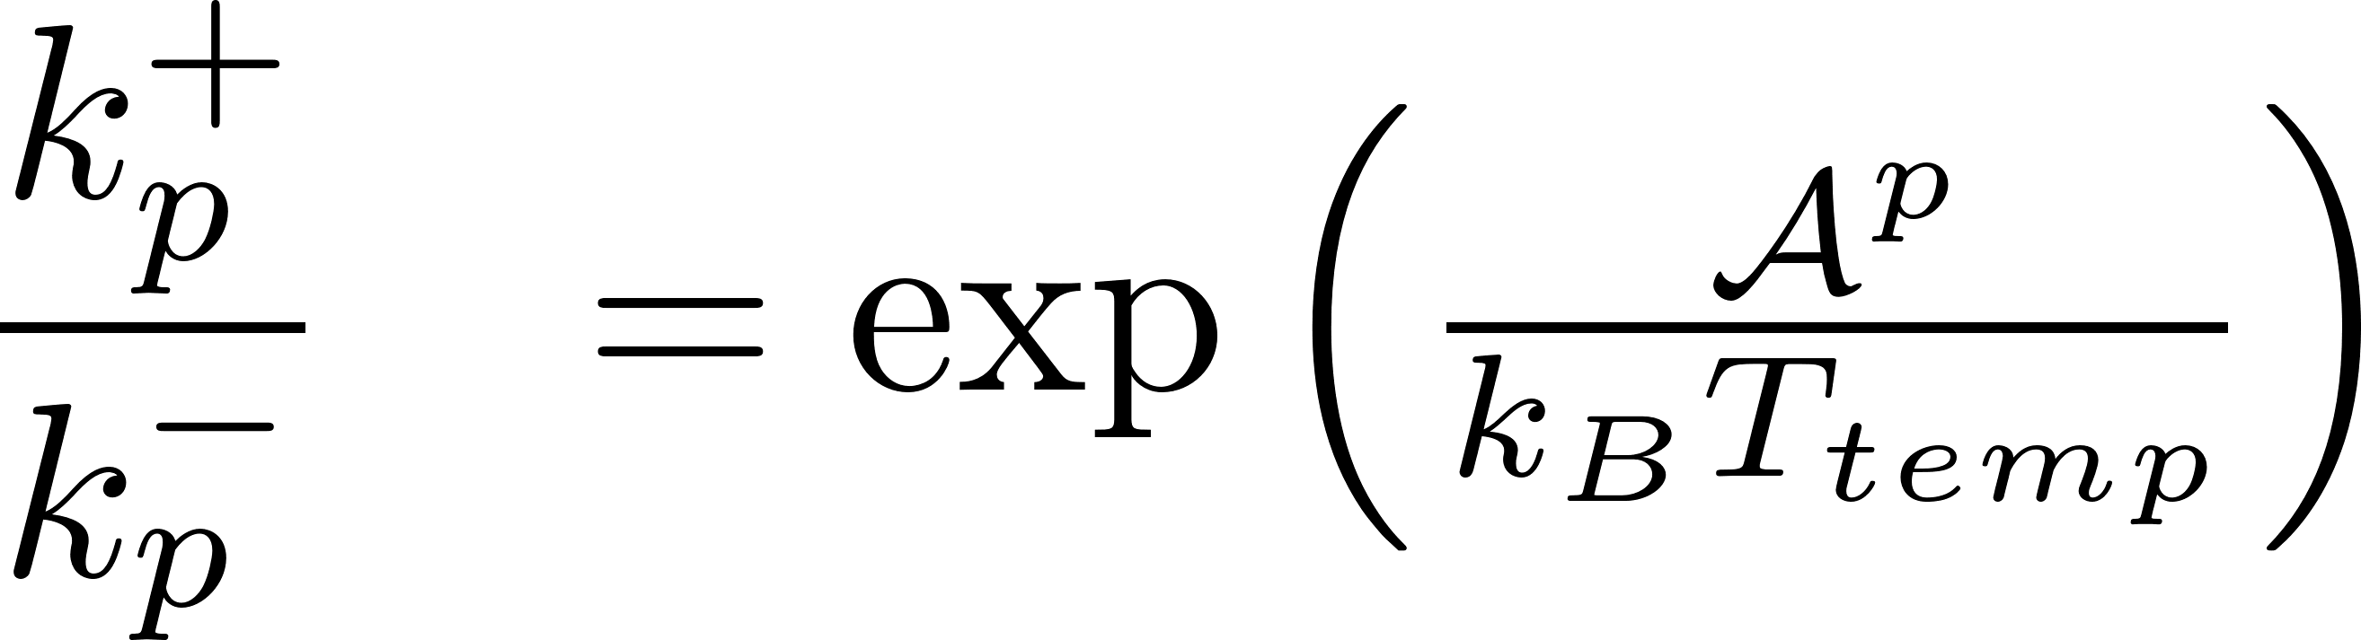
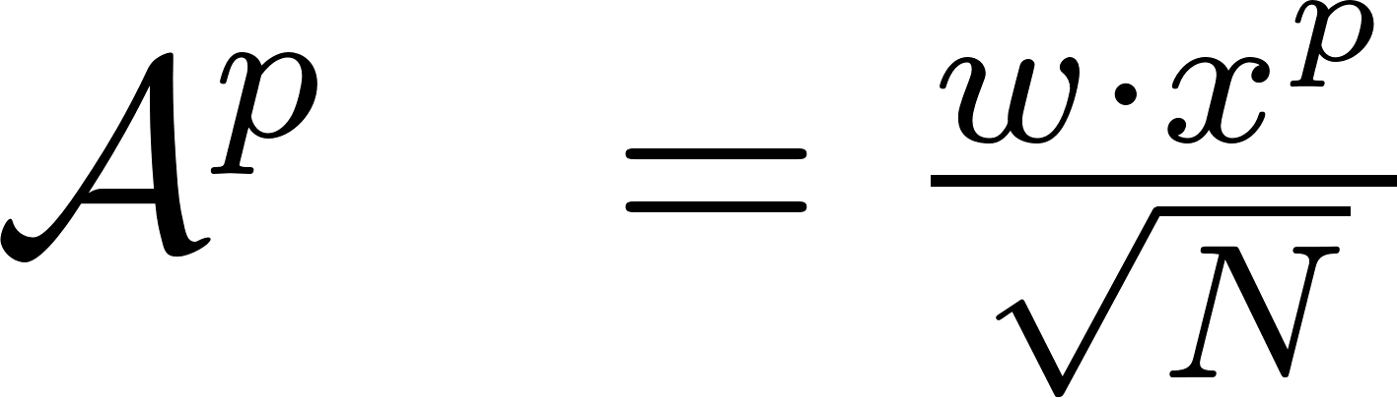
Thermodynamics of Learning
= 1
Notes:
A^p generates the predicted output
k+- = rates

Slide 65
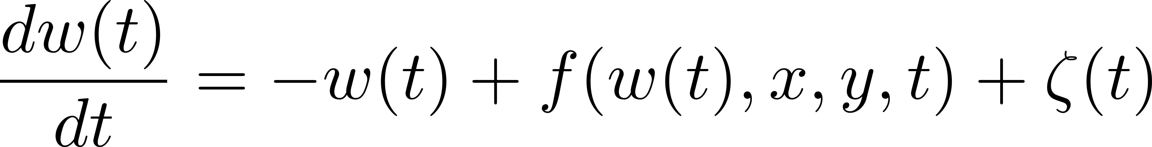
Thermodyn. of Learning – Simple Model
Langevin Equation
Gaussian thermal noise
External force; learning algorithm dependent
Notes:
A^p generates the predicted output
k+- = rates

Slide 66


Thermodyn. of Learning – Simple Model
Probability PDE
Prob. Current of Predicted label
Prob. Current of Weight
Notes:
A^p generates the predicted output
k+- = rates

Slide 67




Thermodyn. of Learning – Simple Model
(Learning Efficiency)
Stationary solution of the above yields $I(y,\hat{y})$
Notes:
A^p generates the predicted output
k+- = rates

Slide 68
Thermodyn. of Learning – Simple Model
(Learning Efficiency)
Difference of entropy of P(w,t) from t₀ to t
Heat dissipated by dynamics of the weight
Notes:
A^p generates the predicted output
k+- = rates

Slide 69

Thermodyn. of Learning – Simple Model
(Learning Efficiency)
Integrate $\hat{y}$ out of PDE → Yields Fokker-Planck Equation
Solve Fokker-Planck Equation → Yields $\operatorname{Pr}\left(y,w,t\right)$
Integrate $y$ out of $\operatorname{Pr}\left(y,w,t\right)$ to get $P(w,t)$
Compute $ΔS\left(w\right)$ from $P(w,t)$
Notes:
A^p generates the predicted output
k+- = rates

Slide 70
Thermodyn. of Learning – Simple Model
(Learning Efficiency)
Notes:
A^p generates the predicted output
k+- = rates

Slide 71

Thermodyn. of Learning – Simple Model
(Learning Efficiency)
$$ν$$
Notes:
A^p generates the predicted output
k+- = rates

Slide 72


Thermodyn. of Learning – Multiple Neurons and Multiple Weights Model
Notes:
A^p generates the predicted output
k+- = rates

Slide 73
Outline
Speech Processing
Speech Recognition
Blind Source Separation
Speech Enhancement
Speaker Verification & Speaker Diarization
Deep Learning Theory
Stochastic Thermodynamics of Learning
Deep Relaxation
Analyzing Neural Networks via Information Theory
Residual Networks as a Mean-Field Optimal Control Problem

Slide 74
Outline
Speech Processing
Speech Recognition
Blind Source Separation
Speech Enhancement
Speaker Verification & Speaker Diarization
Deep Learning Theory
Stochastic Thermodynamics of Learning
Deep Relaxation
Analyzing Neural Networks via Information Theory
Residual Networks as a Mean-Field Optimal Control Problem

Slide 75

Deep Relaxation

Slide 76



Deep Relaxation – Heat Equation
= local entropy
is representative of variance, as well as time for a heat equation solution

Slide 77


Deep Relaxation – Local Entropy Loss
Solution of the viscous Hamilton-Jacobi PDE

Slide 78







Deep Relaxation – Homogenization of Elastic SGDs Elastic SGD = Minimization of Local Entropy
Local Entropy Loss
Elastic SGDs
Consider the following stochastic differential eqns
Neural Networks solve:
Elastic SGDs solve:
with
They then prove that this yields the formulation
Homogenization parameter
They then prove that

Slide 79



Deep Relaxation – Stochastic Optimal Control Interpretation
Solution of the viscous Hamilton-Jacobi PDE
Because
This can then be posed as a stochastic optimal control problem!
Hamilton-Jacobi-Bellman Equation
Control
Quadratic Running Cost
Terminal Cost

Slide 80





Deep Relaxation – Stochastic Optimal Control Interpretation
= minimum expected cost over all controls & paths
= viscosity solution of HJB PDE
with
They show that this specific case leads to
They then finish the paper proving that

Slide 81

Deep Relaxation – The value
helps define the smoothing factor of the Gaussian, which we know it can also represent time.
Decay Rule:
Allows for a smooth loss function in the beginning
Preserve the locations of the minima in the end as approaches 0

Slide 82




Deep Relaxation – Experimental Results
mnistfc | MNIST Dataset
LeNet | MNIST Dataset
All-CNN | CIFAR-10
Notes:
Entropy SGD: L=20
Heat: L=5
Non-viscous HJ Eqn: L=5
SGD: L=1

Slide 83
Deep Relaxation – Experimental Results
Notes:
Entropy SGD: L=20
Heat: L=5
Non-viscous HJ Eqn: L=5
SGD: L=1

Slide 84
Outline
Speech Processing
Speech Recognition
Blind Source Separation
Speech Enhancement
Speaker Verification & Speaker Diarization
Deep Learning Theory
Stochastic Thermodynamics of Learning
Deep Relaxation
Analyzing Neural Networks via Information Theory
Residual Networks as a Mean-Field Optimal Control Problem

Slide 85
Outline
Speech Processing
Speech Recognition
Blind Source Separation
Speech Enhancement
Speaker Verification & Speaker Diarization
Deep Learning Theory
Stochastic Thermodynamics of Learning
Deep Relaxation
Analyzing Neural Networks via Information Theory
Residual Networks as a Mean-Field Optimal Control Problem

Slide 86


Information Theory
How does a network progressively encode/decode information?
Plot

Slide 87



Information Theory
Stochastic Gradient Descent has two phases
Empirical Error Minimization
Representation Compression
T = Whole Layer
X = Input Layer
Y = Final Layer
Encoder
Decoder

Slide 88
Information Theory
Stochastic Gradient Descent has two phases
Empirical Error Minimization
Representation Compression
Encoder
Decoder
Need a measurement that is invariant to any invertible reparametrization of a random variable

Slide 89

Information Theory – Mutual Information

Slide 90

Information Theory – Markov Chain Property
X
Y
Z
Data Processing Inequality
Information is generally lost when transmitted through a noisy channel

Slide 91

Information Theory – Markov Chain Property
Data Processing Inequality

Slide 92

Information Theory – Experimental Setup
50 Randomized Initializations
Cross-Entropy Loss
No Regularizer
Stochastic Gradient Descent
Tanh binned in 30 intervals between -1 and 1
Plot

Slide 93

Information Theory – Evaluate over Number of Epochs
Compression
Empirical Risk Minimization
Epoch 0
Epoch 400
Epoch 9000

Slide 94
Information Theory – Vary amount of Training Data
5%
45%
85%
In all cases, Empirical Risk Minimization is fast!
Then compression is slow…

Slide 95

Information Theory – Vary amount of Training Data
Convergence of the network to a configuration with constant flow of information through the layers

Slide 96

Information Theory – Vary amount of Training Data
Adding layers reduce number of epochs
Compression phase is shorter when it starts from a previous compressed layer (e.g. 5,6)
Compression is faster for the deeper

Slide 98
Outline
Speech Processing
Speech Recognition
Blind Source Separation
Speech Enhancement
Speaker Verification & Speaker Diarization
Deep Learning Theory
Stochastic Thermodynamics of Learning
Deep Relaxation
Analyzing Neural Networks via Information Theory
Residual Networks as a Mean-Field Optimal Control Problem

Slide 99
Outline
Speech Processing
Speech Recognition
Blind Source Separation
Speech Enhancement
Speaker Verification & Speaker Diarization
Deep Learning Theory
Stochastic Thermodynamics of Learning
Deep Relaxation
Analyzing Neural Networks via Information Theory
Residual Networks as a Mean-Field Optimal Control Problem

Slide 100
ResNets as Opt. Ctrl.

Slide 101
Outline
Speech Processing
Speech Recognition
Blind Source Separation
Speech Enhancement
Speaker Verification & Speaker Diarization
Deep Learning Theory
Stochastic Thermodynamics of Learning
Deep Relaxation
Analyzing Neural Networks via Information Theory
Residual Networks as a Mean-Field Optimal Control Problem

